Slide 1


Slide 2


Slide 3


Slide 4
Electronic Parking Lot
http://todaysmeet.com/ESC17STAAR
If overcome with emotion and you want to tweet use the #esc17 as we would love to hear what you have to say!! FOLLOW @instructionalle

Slide 5

ESC 17 Training for the
2013 State Assessment Program
AGENDA
Welcome and Introductions
General Policy Update
Test Security
Test Administration
Assessment of English Language Learners
Assessment of Students with Disabilities
Testing Accommodations for Students with Disabilities
Scoring and Reporting
Wrap-Up / Q & A / Evaluation
Optional for District Testing Coordinators
Online Testing
Assessment Management System
Test Materials and Shipping

Slide 6
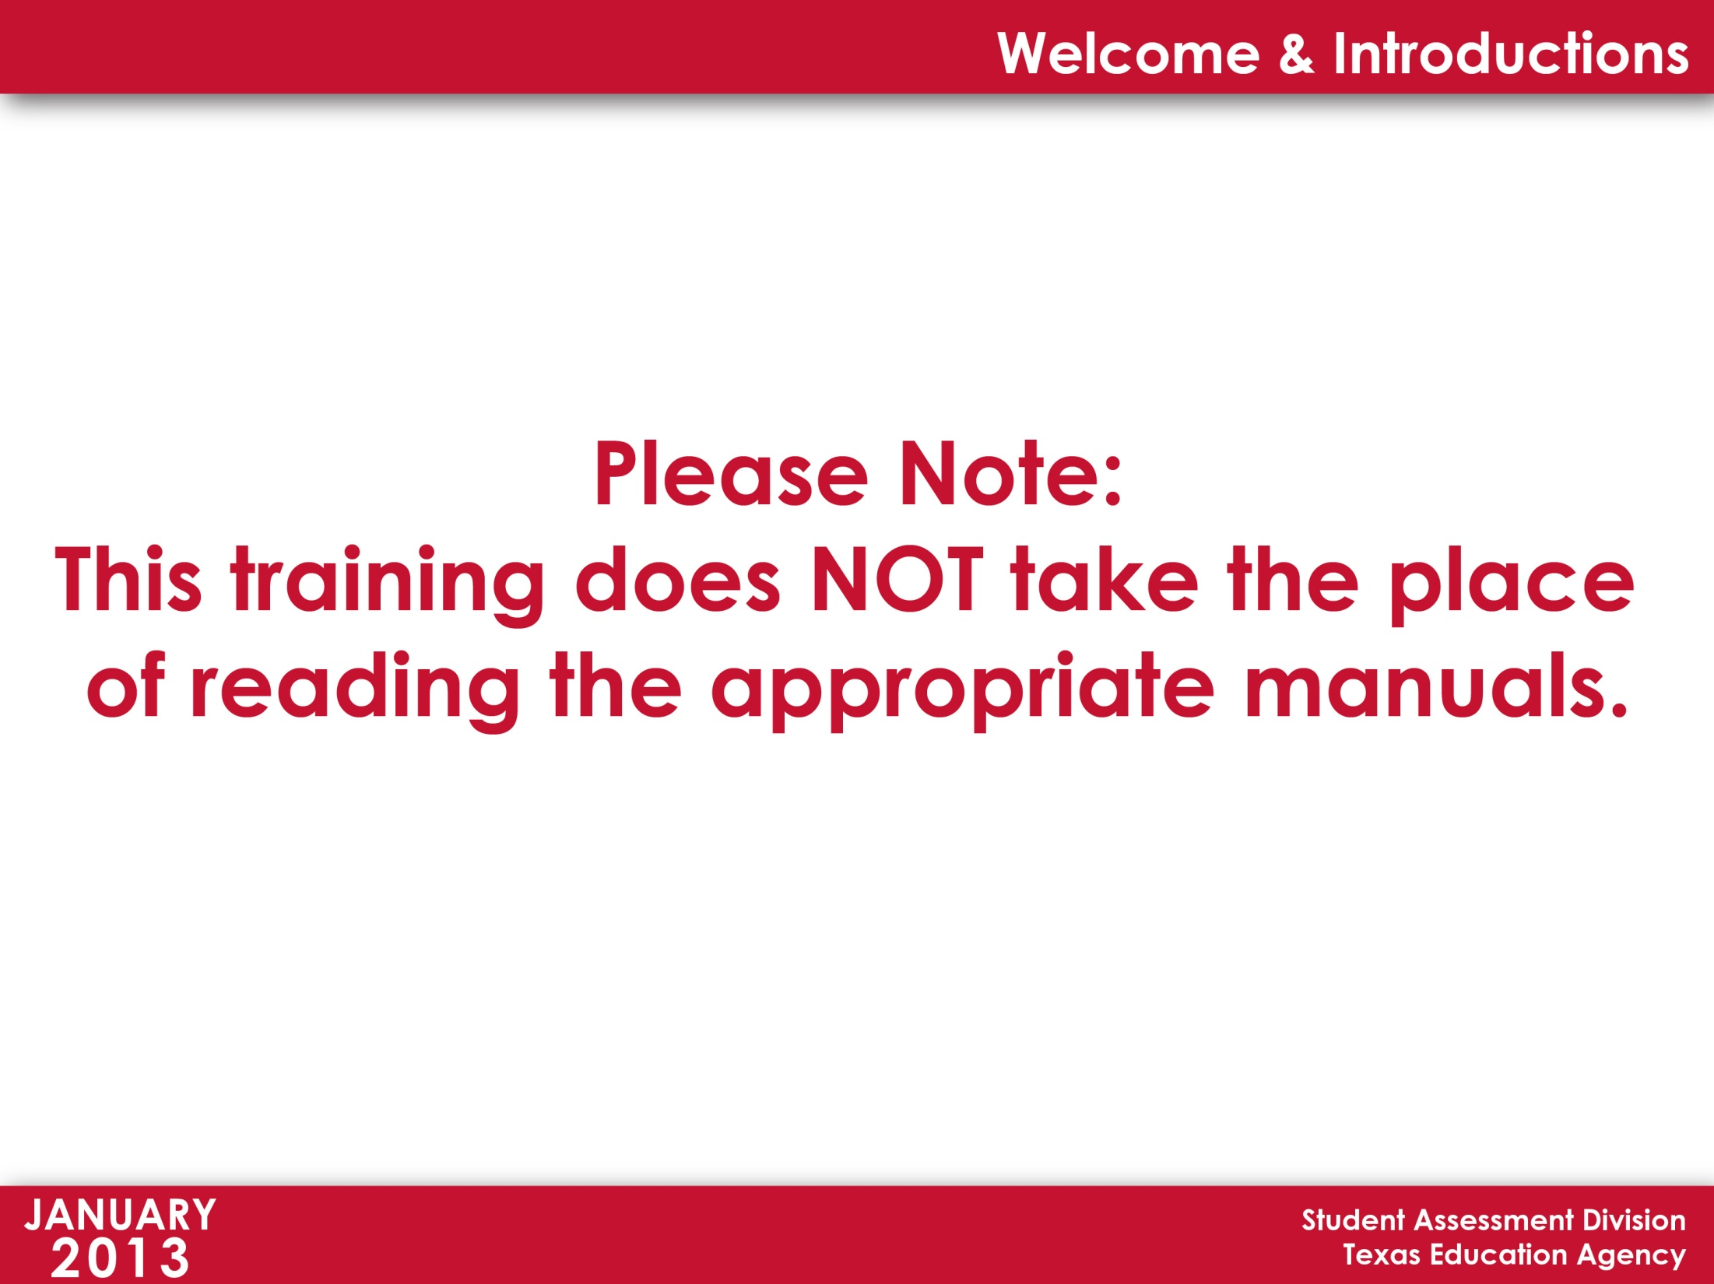

Slide 7


Slide 8


Slide 9




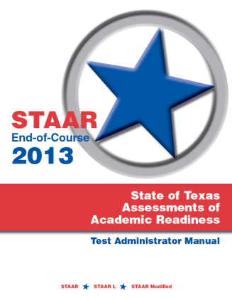
Procedures for maintaining the
security and confidentiality
of a test are specified in the
District and Campus
Coordinator Manual,
the Test Security Supplement, and
in all test administrator manuals.

Slide 10

Security Supplement
Test Security Supplement

Slide 11
Security Supplement
History of the Test Security Supplement
2006 | Introduced to provide districts with additional guidance relating to the proper implementation of testing procedures and to promote increased test security
2007 | 14-point Test Security Plan designed to assure parents, students, and the public that test results are meaningful and valid Secure Materials Supplement released to aid districts in the proper accounting of secure materials
2008 | Test Security Supplement responded to recommendations in the 14-point plan Secure Materials Supplement and Test Security Supplement merged
2012 | Test Security Supplement adopted by the Commissioner of Education and put into Commissioner’s Rules in the Texas Administrative Code [19 TAC §101.3031(b)(2)]
2013 | Remains in code, is updated, and places more emphasis on penalties for violation of security and confidentiality

Slide 12
Security Supplement
It’s the law!
Violation of security or confidentiality of any test required by the Texas Education Code (TEC) Chapter 39, Subchapter B, shall be prohibited. A person who engages in conduct prohibited by the Test Security Supplement may be subject to sanction of credentials.
Conduct that violates security and
confidentiality of a test is defined as any
departure from the test administration
procedures established in the
Test Security Supplement and all other
test administration materials.

Slide 13
Security Supplement
It’s the law!
Any person who violates, assists in the violation of, or solicits another to violate or assist in the violation of test security or confidentiality, and any person who fails to report such a violation is subject to … penalties.
Release or disclosure of confidential test content could result in criminal prosecution under TEC §39.0303 … and section 37.10 of the Texas Penal Code.

Slide 14
Security Supplement
It’s the law!
In addition, any irregularities in test security or confidentiality may also result in the invalidation of student results.
The superintendent and campus principal of each school district and chief administrative officer of each charter school and any private school administering the tests as allowed under TEC §39.033, must develop procedures to ensure the security and confidentiality of the tests … .

Slide 15
Security Supplement
Violation of Security and Confidentiality of Assessments
Conduct that constitutes a severe violation of test administration procedures (serious irregularities) may include the actions listed below.
Viewing a test before, during, or after an assessment unless specifically directed to do so
Duplicating secure material
Disclosing the contents of any portion of a secure test

Slide 16
Security Supplement
Violation of Security and
Confidentiality of Assessments
Conduct that constitutes a severe violation … (cont.)
Assisting an examinee with a response
Providing an examinee with an answer to a test question (this includes suggesting that the examinee review or change his or her response)
Changing or altering an examinee’s response
Encouraging an individual to participate in any of the events listed above
Failing to report to an appropriate authority that an individual engaged in any of the events listed above

Slide 17
Security Supplement
Penalties for Violation of Security and
Confidentiality of Assessments
Penalties for participation in a serious violation of test security or confidentiality may include the following reprimands.
Placement of restrictions on the issuance, renewal, or holding of a Texas teacher certificate
Issuance of an inscribed or non-inscribed reprimand
Suspension of Texas teacher certificate
Revocation or cancellation of a Texas teacher certificate

Slide 18
Security Supplement
Policy and Procedure Highlights
  training requirements
  materials security
  secure storage areas
  test session time limits
  test administration windows, flexible scheduling, and
  make-up testing
  reference materials, charts, graph paper, and scratch
  paper
  student cheating
  investigating and reporting testing irregularities

Slide 19
Security Supplement
Making Your Program Secure
  things to do before, during, and after an administration
Testing Irregularities
  understanding the difference between serious and procedural irregularities
Incident Reporting
  how to respond to testing irregularities
  how to report testing irregularities

Slide 20
Security Supplement
Policy and Procedure Highlights
Training Requirements
Testing personnel are required to receive annual training in test security and administration procedures and to sign an Oath of Test Security and Confidentiality.
Districts that elect to use noncertified paraprofessionals during the administration of a statewide assessment must assign a certified staff member who will be responsible for supervising them.

Slide 21
Security Supplement
Policy and Procedure Highlights
Materials Security
District and campus coordinators are responsible for counting and verifying that all materials as listed on the contractor’s packing list have been received.
Secure Storage Areas
Coordinators are required to place all secure materials in limited-access locked storage when not in use.

Slide 22
Security Supplement
Policy and Procedure Highlights
Test Administration Windows, Flexible Scheduling, and Make-up Testing
Districts are provided the latitude to adjust test dates when a conflict arises for STAAR grades 3-8 and end-of-course (EOC) assessments with the exception of STAAR grades 4 and 7 writing and the STAAR English I, II, and III reading and writing assessments. No notification to TEA is required.
Districts may offer make-up testing opportunities for all grades and subjects to students who are absent on regularly scheduled assessment days. Make-up testing must be completed by the end of the testing window as specified on the Calendar of Events.

Slide 23
Security Supplement
Policy and Procedure Highlights
Four-hour Time Limits
Students will be provided four hours in which to complete STAAR,
STAAR Modified, or STAAR L tests.
Start and Stop Times
- four-hour time period begins after the test administrator
reads directions and tells students to begin working on their
tests
- test administrators must use a clock or timer
- start and stop times must be recorded on the seating chart
- students must record all responses by the end of the four-hour
time period

Slide 24
Security Supplement
Policy and Procedure Highlights
Four-hour Time Limits
“SAY” Directions
- not included in four-hour time period
Announcement of Time Left to Test
- communicate orally or in writing
- one hour intervals, more if desired during last hour

Slide 25
Security Supplement
Policy and Procedure Highlights
Four-hour Time Limits
Breaks Included in the Four-hour Time Limit (not allowed to stop the time clock)
- water breaks - bathroom breaks
- snack breaks - short physical or mental breaks
Breaks NOT Included in the Four-hour Time Limit (required to stop and restart the time clock)
- lunch - emergencies
- movement of students - medical breaks
Remember to record stop and restart times on the seating chart.

Slide 26
Security Supplement
Policy and Procedure Highlights
Four-hour Time Limits
Multiple Test Sessions
- allowed as long as four-hour time limit is maintained
- can start before regularly scheduled school day or extend
beyond

Slide 27
Security Supplement
Policy and Procedure Highlights
Four-hour Time Limits
Extended Time‒Extra Time (same day)
- available for eligible students with disabilities and English
language learners
- students start at the beginning of the school day and are
allowed to test up to the end of the school day, not beyond
Extended Time‒Extra Day (rare)
- for eligible students with disabilities for whom TEA has
approved an Accommodation Request Form
- special procedures and guidelines provided with approval

Slide 28
Security Supplement
Testing Irregularities

Slide 29
Testing Irregularities

Slide 30
Testing Irregularities
2011 – 2012 Incident Reports
(approximate numbers)
Serious 150
Procedural 3980
Total 4130

Slide 31
Testing Irregularities
Serious Irregularities
- constitute severe violations of test security or confidentiality
- can result in the individual(s) responsible being referred to
the TEA Educator Certification and Standards Division for
consideration of disciplinary action
- must be reported to TEA as soon as the district coordinator
is made aware of situation
- must be investigated by coordinator immediately, an
incident report must be filed, and required documentation
must be submitted in a timely manner

Slide 32
Testing Irregularities
Procedural Irregularities
- reflect minor errors, minor deviations in testing
- do not represent severe breaches in security or
confidentiality
- do not require a call to TEA unless guidance needed by
the district
- require an online incident report submission
- require an accurate summary of event
- do not require supporting documentation
- must be submitted within ten working days

Slide 33
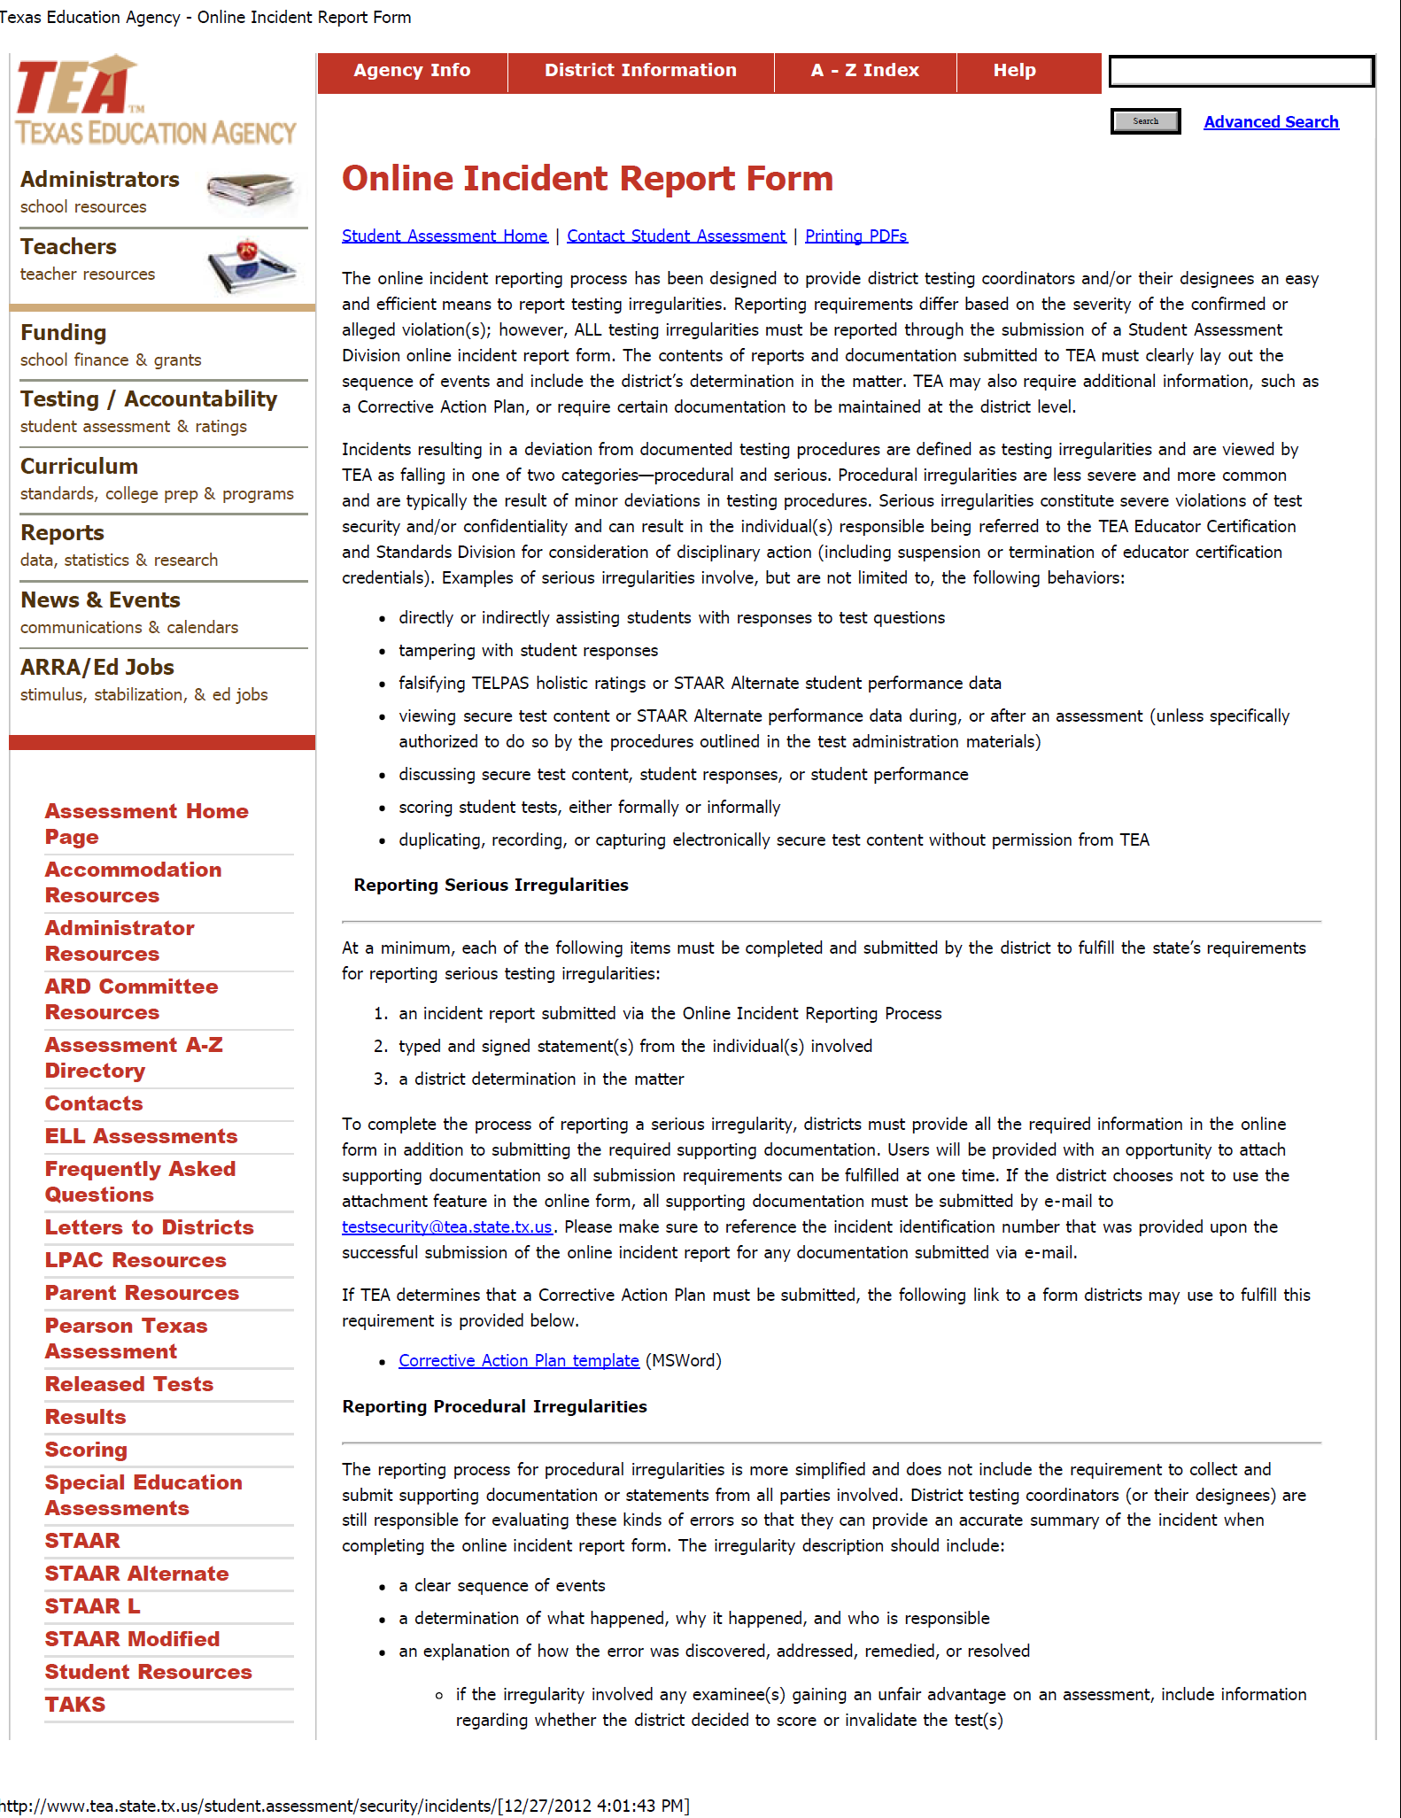
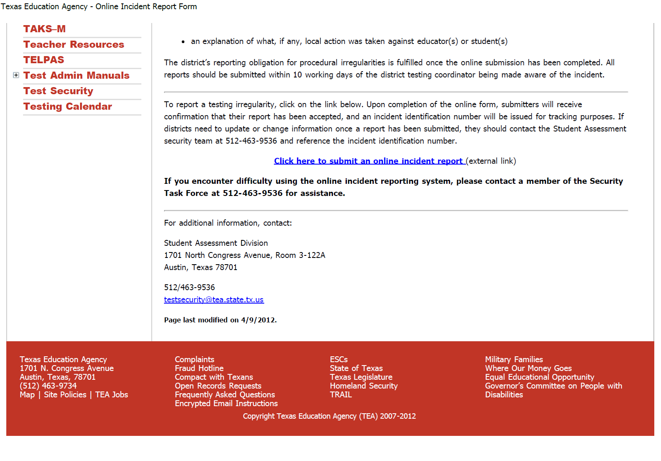
Testing Irregularities
http://www.tea.state.tx.us/student.assessment/security/incidents//

Slide 34
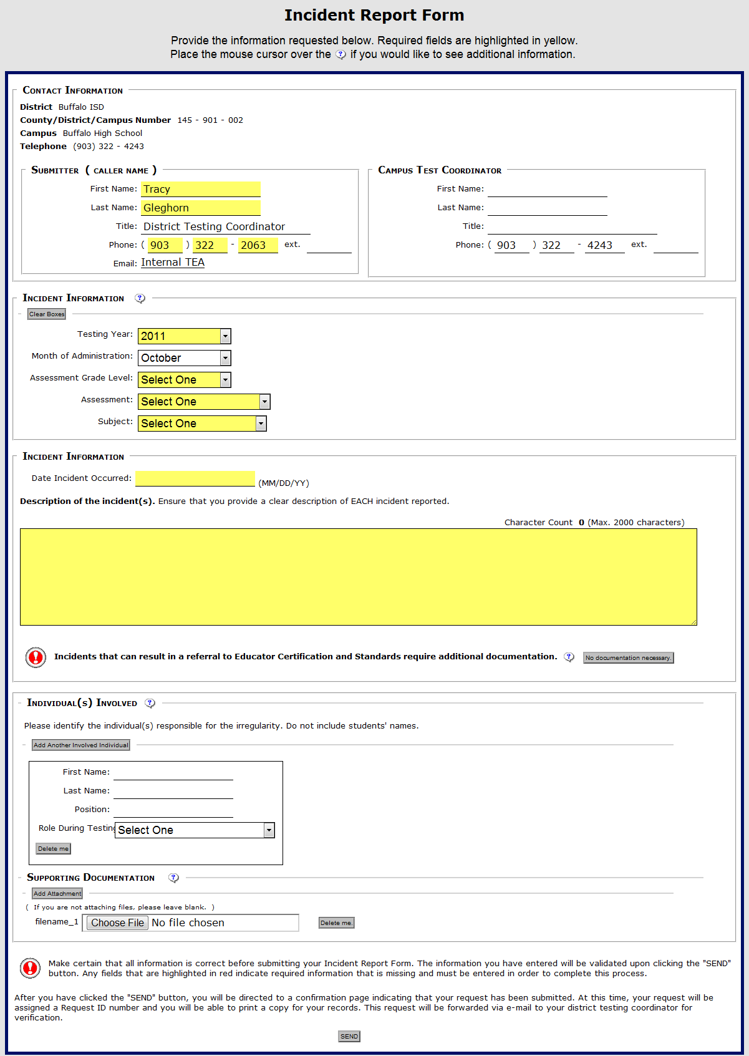
Testing Irregularities
Online Incident Report
It must first be determined if the
reported incident is procedural or
serious.
Serious irregularity incident report
form will have an area in which
required documentation is
uploaded.
Procedural irregularity incident
report form will not have an area
for documentation.

Slide 35
Testing Irregularities
Make the Report
Contact TEA Student Assessment Division security team immediately
- if guidance is needed,
- if students take pictures or transmit any test
information using electronic devices, or
- to notify the security team of the occurrence of a serious irregularity.

Slide 36
Testing Irregularities
Make the Report
Report the irregularity using the online Incident Report Form.
Be sure to
- identify the type of irregularity (procedural vs. serious),
- be succinct in your description of the event, and
- submit documentation for serious irregularities as required.
Check email for a confirmation of receipt of the incident report. This will be sent to the district test coordinator, immediately following submission of the incident report.

Slide 37
Testing Irregularities
Procedural Irregularity
- No documentation is required.
- Provide in your report a thorough yet succinct description of
events including a determination of the event.
- TEA security team will review the online incident report.
- If more information is needed, TEA security team will send the
DTC an Additional Action Required notice.
- If no further action is required, then the DTC will receive an email
response letter closing the record (new).

Slide 38
Testing Irregularities
Serious Irregularity
- Documentation is required.
- Provide in your report a thorough yet succinct description of
events.
- If your investigation is complete, provide district determination
in your description.
- TEA security team will review the online incident report.
- If more information is needed, TEA security team will send the
DTC an Additional Action Required notice.
- Once reviewed, the TEA security team will send the DTC and the
superintendent a response letter to either close the record or to
show that a referral for sanctions has been sent to the Educator
Standards and Certification Legal Division.

Slide 39
Testing Irregularities
Additional Action Required Notice (new)
- In order to process the reported incident, the TEA security team
may need additional information.
- If further action or information is required, the DTC will receive an
Additional Action Required notice via email.
- The DTC will be asked to submit the information requested or to
contact the security team within ten working days.
- If a response is not received, and depending on the
circumstances, the Director of Test Administration will contact
the DTC to provide support or will contact the superintendent to
seek assistance.

Slide 40
Testing Irregularities
Additional Action Required Notice (new)
Benefits of a quick response include
- the collection of more accurate information,
- the potential to preserve students’ tests and provide them with
the score they deserve,
- faster responses for all individuals involved, and
- the ability of the DTC to close business from one test
administration before moving onto another.

Slide 41
Testing Irregularities
Pointers about Collecting Information and Making a Report
Identify
- what happened,
- where and when the incident occurred,
- who was involved, and
- how or why the incident occurred.
Consider what you will do to ensure that the incident is not likely
to reoccur.
Determine if the incident is a serious or procedural irregularity–if it is a serious irregularity, contact TEA right away.
Immediately begin the collection of documentation for a serious
irregularity.
Do not be reluctant to contact the Student Assessment security team for guidance.

Slide 42
Testing Irregularities
We need your district determination of the event.
Procedural irregularity
- Include a summary and a determination of events in the online
incident report.
Serious irregularity
- If district has made a final determination of events before the
incident is reported, include in the online incident report.
- If district has not made a final determination of events, continue
to submit all the information you can in an online incident report
and follow up with determination later.

Slide 43

Resources

Slide 44
Resources
Test Security Webpage
http://www.tea.state.tx.us/student.assessment/security/
- 2013 Test Security Supplement
- Web-based Test Administrator Training Modules
- Online Incident Report
- Oaths of Test Security and Confidentiality
PowerPoint Presentations from the 2012 Assessment Conference
http://www.tea.state.tx.us/student.assessment/tac/
- Test Security Update
- Testing Irregularities in 3D
Launch of Web-based Texas Test Administrator
Online Training Modules
www.TexasAssessment.com/TAonlinetraining

Slide 45

Testing Calendar
Manuals
Test Administration
- Optional Test Administration Procedures and Materials
- English Language Arts
- SSI

Slide 46
2013 Calendar
2013 STAAR
grades 3–8 mathematics
grades 3–8 reading
grades 4 and 7 writing
grades 5 and 8 science
grade 8 social studies
end-of-course (EOC) – fifteen tests

Slide 47
2013 Calendar
2013 STAAR
STAAR Spanish - grades 3–5
STAAR L - grades 3–8 (except for reading and writing)
- EOC (except for English I, II, and III reading and
writing)
STAAR Modified - grades 3–8
- EOC (except for English III, Algebra II, chemistry, physics, and U.S. history)
- world history will be offered as an operational field test
STAAR Alternate - grades 3–8
- EOC (except Algebra II, physics, and chemistry)

Slide 48
2013 Calendar
TELPAS
grades K – 12 - all English language learners
classified as limited English
proficient (LEP)
TAKS and - English language arts,
TAKS (Accommodated) mathematics, science, and
exit level social studies
TAKS-M - English language arts,
grade 11 mathematics, science, and
social studies
TAKS and - English language arts,
TAKS (Accommodated) mathematics, science, and
exit level retest social studies

Slide 49
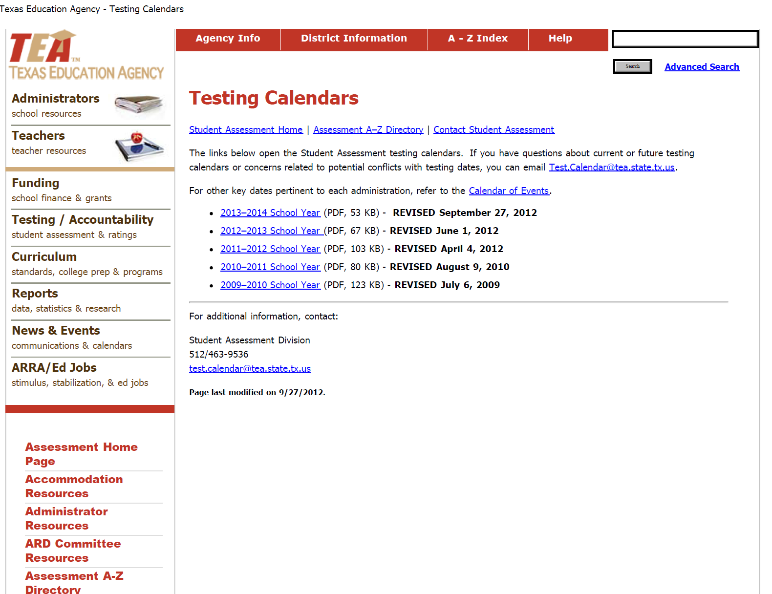
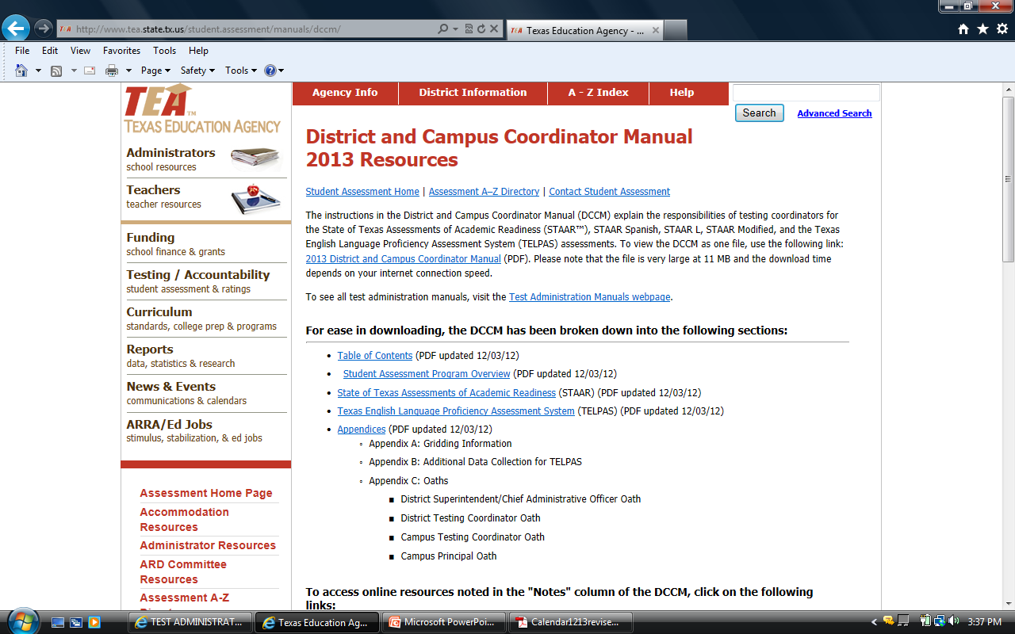
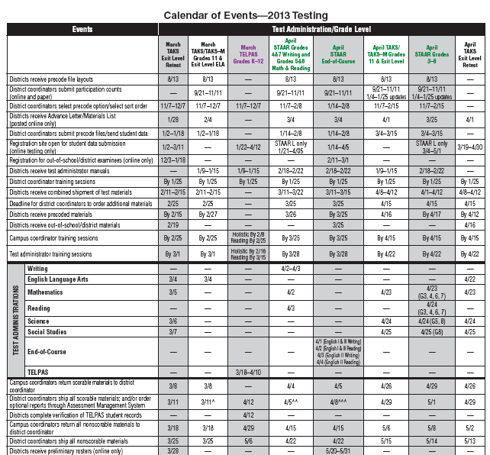
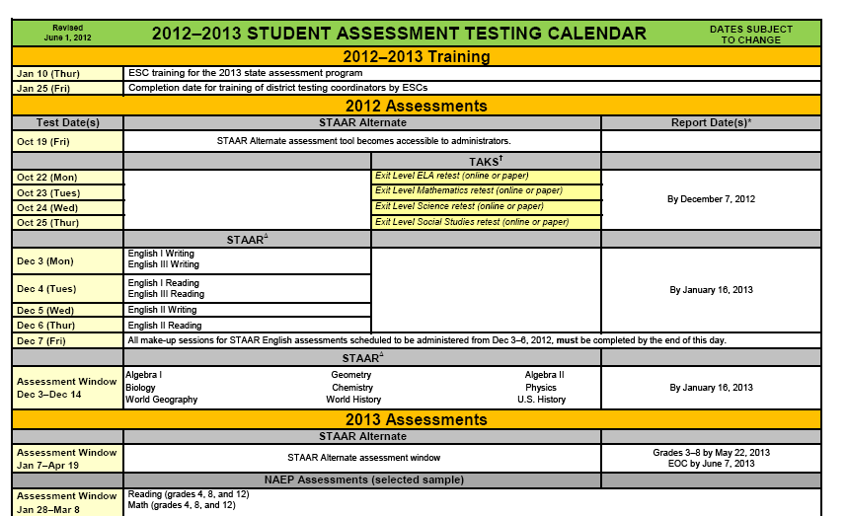
2013 Calendars
http://www.tea.state.tx.us/student.assessment/calendars/
http://www.tea.state.tx.us/student.assessment/manuals/dccm/

Slide 50
2013 Calendar
Reminders
TAKS grade 10 assessments are no longer available.
STAAR Modified is not available for English III, Algebra II, chemistry,
physics, and U.S. history.
STAAR Modified will be offered in world history only as an operational
field test.
Retesting opportunities have been added for grades 5 and 8 mathematics
and reading.
Shipping dates for English I, II, and III scoreable materials are one week
earlier than other EOC scoreable materials for the July and December
administrations.

Slide 51
2013 Calendar
Scheduling of Tests
TEA will continue to allow districts flexibility regarding the 2012-2013 testing
calendar (detailed in letter dated 7/22/11).
If a conflict exists, districts are provided flexibility to change the administration
dates (of certain content-area tests) to accommodate local needs without
having to contact the agency.
Districts may adjust the testing calendar for reading, mathematics, science,
and social studies assessments in grades 3-8.
EOC tests (with the exception of English I, II, and III) are administered within
a window.
Districts do not have the flexibility to change testing dates for
English I, II, and III or grades 4 and 7 writing.

Slide 52

2013 Manuals
2013 District and Campus Coordinator Manual
- STAAR
- TELPAS

Slide 53
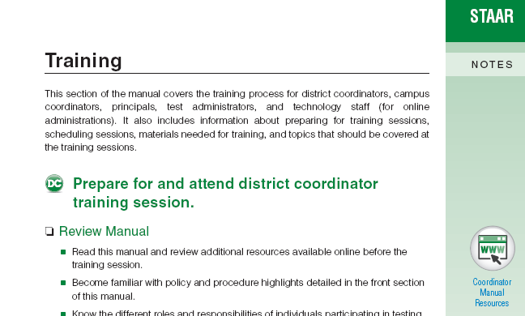
2013 Manuals
  2013 District and Campus
  Coordinator Manual
Limited to action items
Streamlined and simplified
content (bullet points and
subheads)
Action-oriented checklists
embedded in text
(also available on website)
“Notes” column for jotting
down information
“Notes” column with
live links to resources

Slide 54
2013 Manuals
  2013 District and Campus
  Coordinator Manual
DTC and CTC activities
interwoven
Activities are designated “DC,”
“CC,” or “DC/CC”
At district request, some
supporting material has been
included in the manual

Slide 55
2013 Manuals
Updates to the District and Campus Coordinator Manual
Expanded Calendar of Events to run January 2013‒December 2013
Added instructions from online Additional Resources to DCCM
Paired online Additional Resources to items in the Coordinator Manual
more often
Added emphasis in Coordinator Manual on principal’s role
Added emphasis in manuals for test administrators to notify
campus coordinators and for campus coordinators to notify district
coordinators when questions or concerns arise
Added information about STAAR L where appropriate

Slide 56
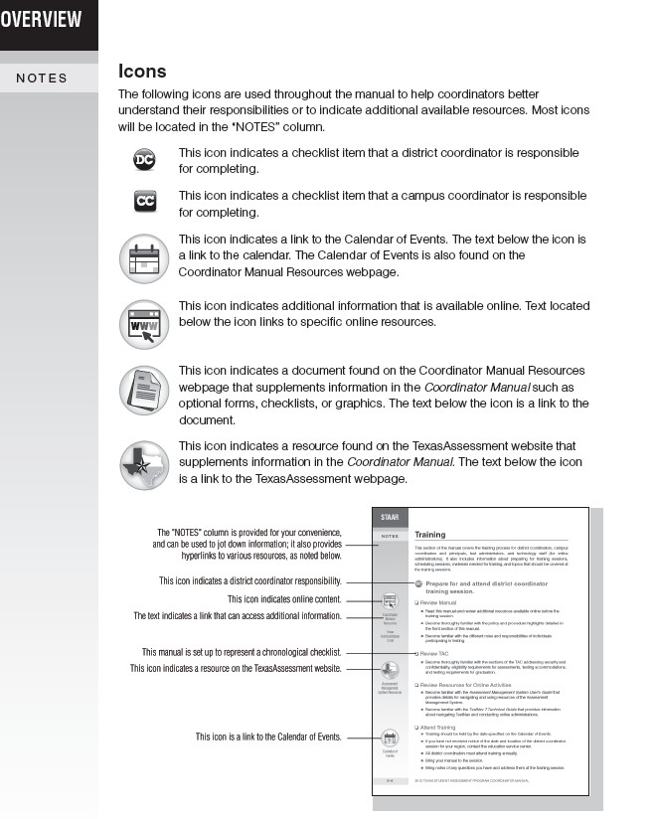
2013 Manuals
  2013 District and Campus
  Coordinator Manual
Added more information about
the organization of the manual
and how to use it

Slide 57
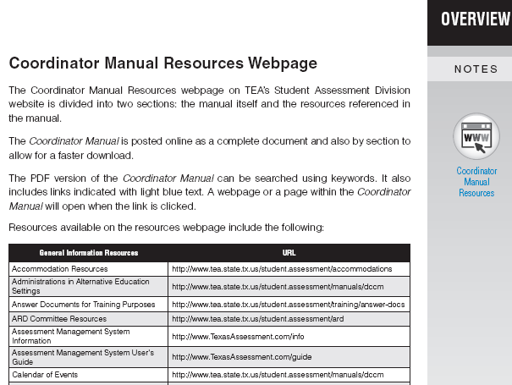
2013 Manuals
  2013 District and Campus Coordinator Manual
Features a list of links to all
of the online resources so
hard-copy manual users
get a better idea of extra
information available online

Slide 58
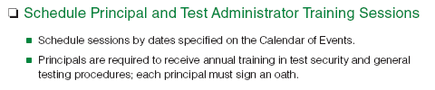
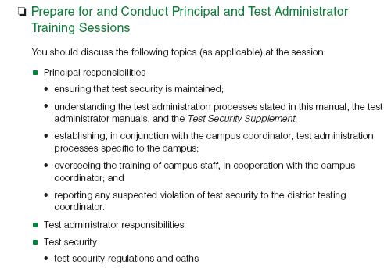
2013 Manuals
  2013 District and Campus
  Coordinator Manual
Responsibilities for campus
principals outlined in greater
detail

Slide 59
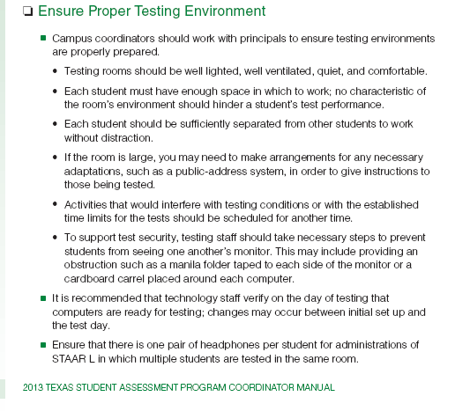

2013 Manuals
  2013 District and Campus
  Coordinator Manual
STAAR L information
added where applicable

Slide 60
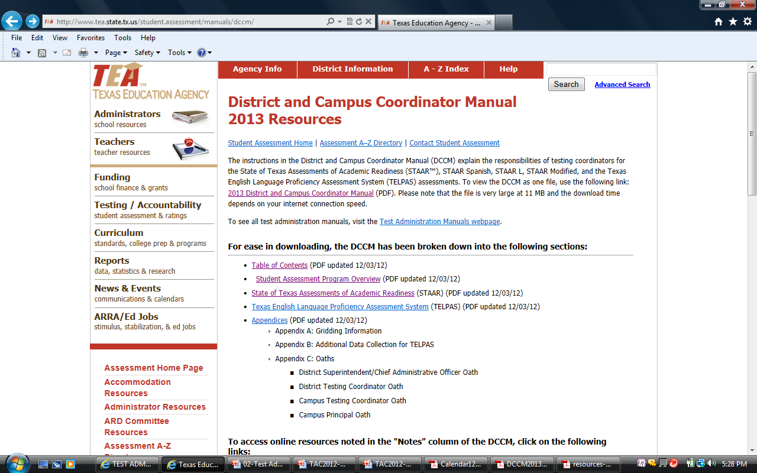
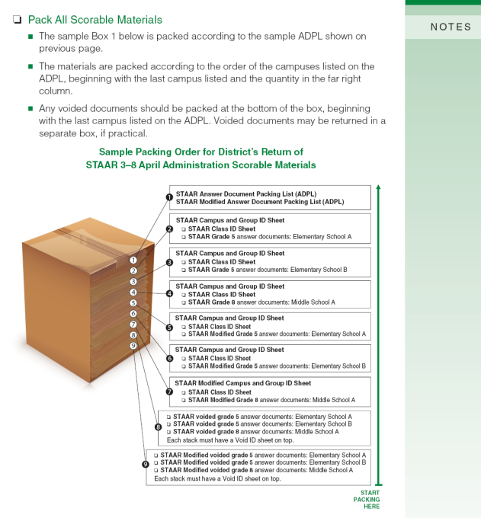
2013 Manuals
  2013 District and Campus
  Coordinator Manual
Even though some have been
added to the Coordinator
Manual, all online resources
have been updated and remain
posted online

Slide 61
2013 Manuals
  STAAR Test
  Administrator Manuals
  - Grades 3-5
  - Grades 6-8
  - End-of-Course
  Include general information and test
  administration directions for STAAR,
  STARR Spanish, STAAR L, and
  STAAR Modified
  Due in districts by February 22, 2013
  Will only be shipped once
  Must be retained
  throughout the year!

Slide 62
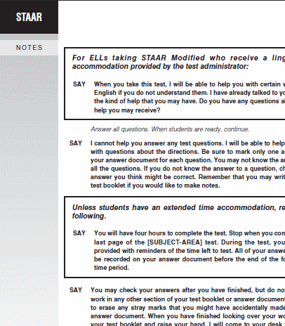
2013 Manuals
Test Administrator
Manuals
Same style as Coordinator
Manual
Scripts cover multiple
subjects and programs
To accommodate some
differences in programs,
the scripts use callout
boxes
Wider boxes have program-
specific and subject specific
instructions

Slide 63
2013 Manuals
Removed sections in test administrator manuals that directed test
administrators to verify student data and to pack materials
Added a section page number list on the Test Administration
divider page to highlight the start of the different scripts
Added more detailed information to the Guide to the Test
Administration Directions section, which is located just before the
scripts
- added general accommodation information
- makes this required reading for test administrators
Added separate scripts for online STAAR L
Updates to Test Administrator Manuals

Slide 64
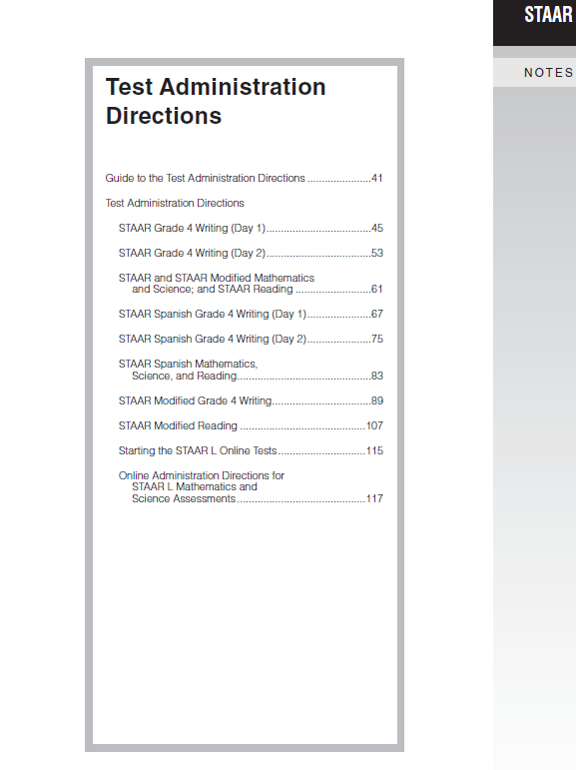
2013 Manuals
Test Administrator
Manuals
Page numbers are listed at the beginning of the Test Administration Directions section for the Guide to the Test Administration Directions and for the scripts

Slide 65
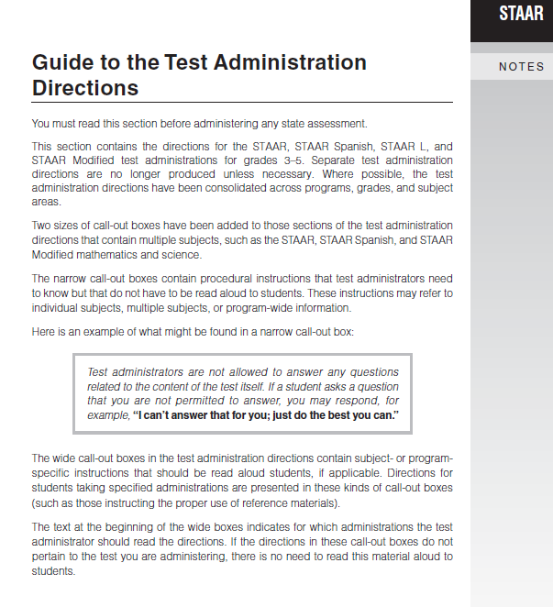
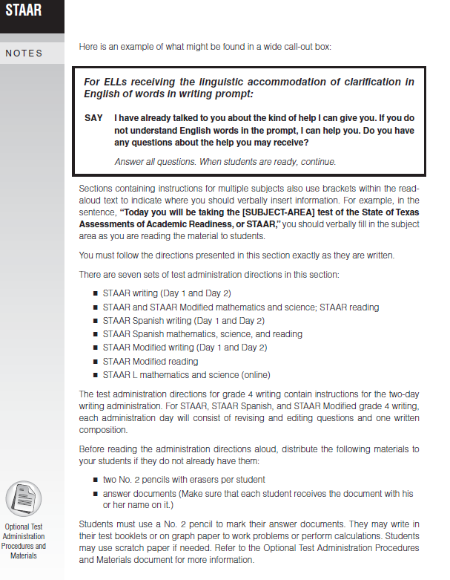
2013 Manuals
Test Administrator
Manuals
The Guide to the Test Administration Directions has specific information about accommodations, including oral administration, that must be read by the test administrator prior to the administration of the test.

Slide 66
2013 Manuals
Test Administrator
Manuals
The Guide to the Test Administration Directions provides
- directions about call-out
boxes,
- details on how to make “SAY”
directions test specific, and
- information about the
distribution of reference
materials and the use of
optional test administration
procedures.

Slide 67
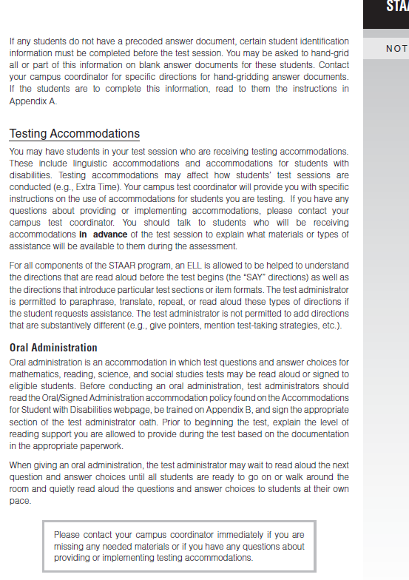
2013 Manuals
Test Administrator
Manuals
Guide to the Test Administration Directions
- includes information about
the use of testing
accommodations,
- describes the Oral Administration
accommodation, and
- reiterates that the test
administrator must have training
and guidance from the campus
coordinator regarding the use of
accommodations prior to the
test administration.

Slide 68
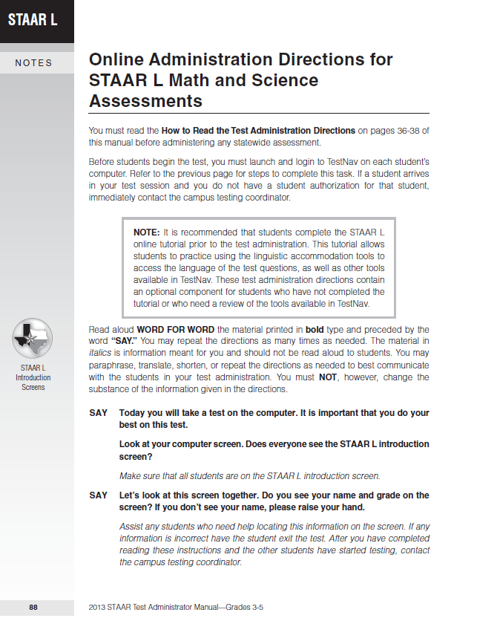
2013 Manuals
Test Administrator
Manuals
STAAR L scripts for online testing are separate from other scripts

Slide 69
2013 Manuals
Test Administrator
Manuals
Please retain
your manuals
for use
throughout
the calendar year.

Slide 70

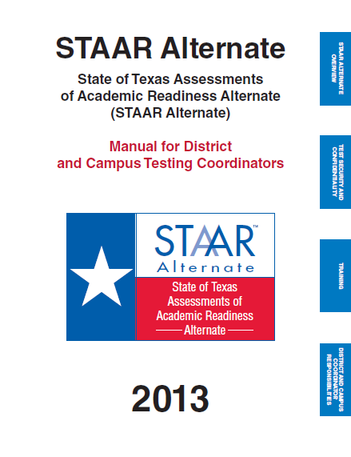
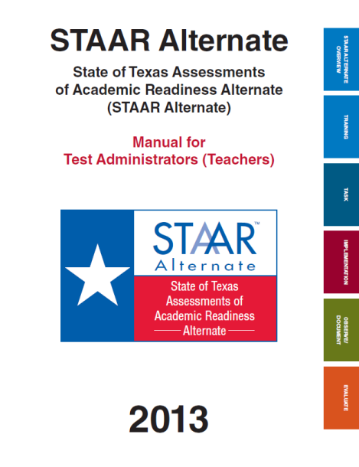
2013 Manuals
TAKS,
TAKS (Accommodated),
and TAKS‒M
- Exit level and grade 11
- Due in campuses by January 8
STAAR Alternate
Available online
http://www.tea.state.tx.us/student.
assessment/special-ed/staaralt/manuals/

Slide 71
STAAR Optional Test Administration
Procedures and Materials
Allowed for any student who needs them, not necessarily every student
Students must have a need and have previously used in the classroom
Use on test is not recorded on the answer document
Documentation is not required beyond what is necessary for planning on testing day
The Optional Test Administration Procedures & Materials document is located in the following places:
  2013 District and Campus Coordinator Manual
  District and Campus Coordinator Manual Resources webpage
  STAAR Test Administrator Manuals
  Accommodation Resources webpage

Slide 72
Optional Test Administration Procedures and Materials
What procedures and materials are available to ALL students?
Preferential seating
Special lighting conditions
Signing or translating test administration directions
Reading the test aloud to self
Reading aloud or signing the personal narrative, expository, literary, or persuasive writing prompt
Reading assistance on the
grade 3 mathematics test
Scratch paper or other material to use as workspace
Minimizing distractions
Colored overlays
Magnifying devices
Blank place markers
Highlighters, colored pencils, or crayons

Slide 73


Slide 74
STAAR English I, II, and III
Separate test booklets for reading and writing
Separate answer documents for reading and writing
Separate scores for reading and writing
STAAR Modified English I and II
Separate test booklets for reading and writing
A combined answer document for reading and writing
Separate scores for reading and writing

Slide 75
Mandatory Sampling
English III Reading and English III Writing
Selected campuses statewide
Participants are English III students whose graduation requirement is TAKS
Participants will take either an English III reading or an English III writing test, not both
English III student information MUST be included in your student-data upload in order to receive precoded labels.

Slide 76
STAAR Writing: New Tracking Method
A new graphic is being used on all STAAR writing tests to help students correctly link each prompt in the test booklet to its corresponding lined page in the answer document.
The graphic is located at the top of each prompt page and the top of each lined page.
The graphic is a 3½-inch rectangle containing a unique set of symbols (triangles, squares, or diamonds) for each composition students have to write.

Slide 77
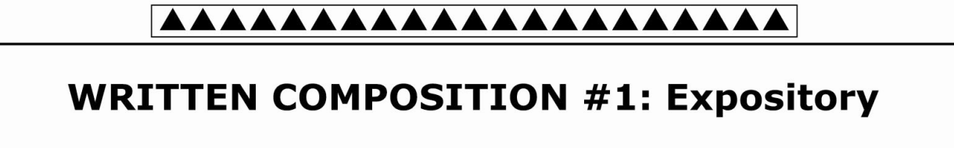
READ the following quotation.
A famous businessman once said, “Players win games; teams win championships.”
THINK carefully about the following statement.
Sometimes you can accomplish good things by yourself but better things with other people.
WRITE an essay explaining whether it is better to work by yourself or with a group.

Slide 78


Slide 79
Composition Retention and Duplication
Districts are not permitted to retain copies of student compositions or short answer responses.
Districts may not order electronic copies.
The April 2013 English II expository and persuasive student essays will be posted to the Texas Assessment Management System in summer 2013.

Slide 80


Slide 81
Applies to students in grades 5 and 8 who take STAAR and STAAR Modified mathematics and reading assessments
Does NOT apply to English language learners in grades 5 and 8 who
  are eligible to take a STAAR L mathematics assessment
  are eligible to take a STAAR reading assessment with linguistic accommodations

Slide 82
Students have three testing opportunities: beginning of April, middle of May, and end of June.
To meet SSI promotion requirements, students must meet Phase-in 1 Level II standard in reading and mathematics.
To be promoted by the Grade Placement Committee (GPC), students must participate in all required accelerated instruction.

Slide 83
Scheduled to be delivered to districts in January
  the SSI parent brochure (in English and Spanish), which has been combined for 5th and 8th grades to simplify distribution
  Scheduled to be posted to the Student Assessment Division’s website in February
  Two sets of SSI forms applicable to the 2012−2013 school year: one set for 5th and 8th grade mathematics and one set for 5th and 8th grade reading (both sets in English and Spanish)
  an abbreviated SSI manual (formerly called the GPC manual)

Slide 84


Slide 85
ELLs and STAAR

Slide 86
Proposed Revision to 19 TAC §101.1005
Proposed amendment would permit certain qualifying ELL asylees and refugees in their first year in U.S. schools to be exempted from a STAAR administration
Would apply to assessments in grades 3–8 only
Exemption would be limited to 1 year to comply with federal law
Proposed rule published in Texas Register: 1/4/13
30-day public comment period closes: 2/4/13
Proposed effective date: 3/31/13

Slide 87
Points to Review in Training
STAAR Spanish for grades 3–5 only
STAAR L for mathematics, science, and social studies only, not reading and writing
Linguistic accommodations not just for STAAR L
ELL assessment decisions must be made on an individual student basis by LPAC, and, in the case of an ELL receiving special education services, by the LPAC in conjunction with the ARD committee
  Note: Decisions for an entire grade or program are not authorized (e.g., all 4th grade students in a bilingual program take the Spanish-version reading assessment and English-version mathematics assessment)

Slide 88
STAAR Spanish and STAAR L
STAAR Spanish For ELLs for whom Spanish version of STAAR is most appropriate measure of academic progress
STAAR L ELLs for whom all of these apply may take STAAR L: STAAR Spanish not most appropriate measure of academic progress (or does not exist at student’s grade) Student has not yet attained advanced high TELPAS reading rating Student is within first 3 years in U.S. schools (unless unschooled asylee/refugee, then first 5)

Slide 89
Alignment of STAAR,
STAAR Spanish, and STAAR L
Same:
Assessed curriculum and item types
STAAR blueprints for building tests
Achievement standard alignment
Focus on readiness for next grade level or course with goal of postsecondary readiness
Differences have to do with language accessibility:
STAAR Spanish uses native language to help students understand test
STAAR L provides English-language accommodations
to help students understand test

Slide 90
ELL Participation in
STAAR Modified and STAAR Alternate
ELLs receiving special education services who meet requirements for STAAR Modified or STAAR Alternate may take these assessments
Small number of ELLs
ELLs participate only on basis of disability, not second language acquisition

Slide 91
Differing Degrees of Linguistic Accommodation
STAAR Spanish: Assessment is provided in student’s native language; other linguistic accommodations not applicable
STAAR (English) | Limited degree of linguistic accommodation
STAAR L | Moderate to substantial degree of linguistic accommodation
STAAR Modified | Degree varies in accordance with second language acquisition needs of ELLs who qualify for this test
STAAR Alternate | No specified linguistic accommodations; observational, classroom-based assessment design allows other languages and communication methods to be used as needed

Slide 92
Linguistic Accommodations
STAAR
*Dictionary access to be provided for all students in grade 6 and up as part of STAAR dictionary policy
Math, Science, Social Studies | Reading, Writing
Bilingual dictionary Extra time (same day) | Grades 3–5: Dictionaries of various types* Extra time (same day) Clarification in English of meaning of words in writing prompt words in short-answer reading questions (English I–III)

Slide 93
Linguistic Accommodations
STAAR L
*Provided in online interface beginning spring 2013
Math, Science, Social Studies
Clarification in English of word meaning* Reading aloud of text* Bilingual dictionary Extra time (same day)

Slide 94
Linguistic Accommodations
STAAR Modified
*Unique to STAAR Modified
**Dictionary access to be provided for all students in grade 6 and up as part of STAAR dictionary policy
Math, Science, Social Studies | Reading, Writing
Clarification in English of word meaning Oral translation* Reading aloud of text Bilingual dictionary Bilingual glossary* Extra time (same day) | Clarification in English of word meaning Oral translation* Reading aloud of eligible text Dictionaries of various types (grades 3–5) ** Extra time (same day)

Slide 95
Dictionaries
Two sources for dictionary policies for ELLs taking STAAR:
  STAAR dictionary policy
  Applies to reading and writing assessments in grade 6 and above
  Available at http://www.tea.state.tx.us/student.assessment/staar/reading/
  Linguistic Accommodations for ELLs Participating in the STAAR Program guide
  Outlines policies for the use of dictionaries on all other tests not covered under the STAAR dictionary policy
  Available at http://www.tea.state.tx.us/student.assessment/accommodations/

Slide 96

STAAR L 3–8 and EOC
Transition from Paper to Online Mode
 | 2012 | 2013 AND BEYOND
Clarification in English | Provided by Test Administrator | Provided in Online System
Reading Aloud of Text | Provided by Test Administrator | Provided in Online System
Bilingual Dictionary
Extra Time (Same Day)

Slide 97
STAAR L Online Student Tutorials
Available January 2013 at
  http://www.TexasAssessment.com/STAARL-tutorials and
  http://www.tea.state.tx.us/student.assessment/ell/staarl/
Administration directions for each tutorial will also be posted
Tutorials should be used to familiarize students with clarification and read aloud accommodations and standard TestNav tools
Test administration directions for spring 2013 STAAR L assessments will assume some familiarity with online interface

Slide 98
STAAR L EOC Eligibility
For EOC, eligibility for STAAR L can be carried over from spring to the July and December administrations
Example: A student was in his 3rd year in U.S. schools in the 2011–2012 school year. He took STAAR L in May, but did not meet the minimum score. The LPAC may carry over eligibility to both the July 2012 and December 2012 STAAR L EOC administrations. In spring 2013, however, he would be in his 4th year in U.S. schools and no longer eligible for STAAR L.

Slide 99
Special English I and II EOC Provisions
TAC §101.1007
For ELLs who ―
have been enrolled in U.S. schools 3 school years or less (5 or less if qualifying unschooled asylee/refugee)
and
have not yet attained TELPAS advanced high reading rating
Why these provisions? In English I and II/ESOL I and II courses, these students may require substantial instructional scaffolding and linguistic adaptation not feasible on standardized language arts assessments.

Slide 100
Special Provisions
When enrolled in English I or II/ESOL I or II course, eligible ELL shall not be required to ―
include assessment score in cumulative score for graduation
retake assessment each time it is administered if student passes course but does not achieve minimum score

Slide 101
  Special English I/II EOC Provisions
  Note:
  Students must take assessment while in the course
  Provisions do not apply to English III
  Students may graduate under any of the graduation programs (Minimum, Recommended, Distinguished) as long as they fulfill the corresponding requirements
  LPAC is not required to meet to re-establish eligibility for students that fail a spring course and re-enroll in the course in the subsequent summer or fall. Eligibility in spring carries over to summer and fall

Slide 102
ELLs with Parental Denials
TAC §101.1005 (f)
These students are not eligible for special ELL assessment, accommodation, or accountability provisions ―
No testing in Spanish
No linguistic accommodations during testing
No English I/II EOC special provisions
No unschooled asylee/refugee provisions

Slide 103
ELL Policy Resources
Test participation
www.tea.state.tx.us/student.assessment/ell/lpac/
  STAAR
  TAKS
  TELPAS
Accommodations
www.tea.state.tx.us/student.assessment/accommodations/
  Linguistic accommodations
  Accommodations related to disabilities

Slide 104
SSI Policies
SSI policies related to recent immigrant ELLs and unschooled asylees/refugees undergoing agency review
Policies will be finalized and disseminated in a letter to districts in time for implementation

Slide 105
Planning for
Test Administrations

Slide 106
Coordination Between
LPAC and Testing Coordinators
Testing coordinators should coordinate with LPAC to obtain participation and accommodation decisions in time to make testing arrangements
Linguistic accommodations not just for STAAR L

Slide 107
Sample Forms for Documenting Participation & Accommodation Decisions
Record of STAAR participation and linguistic accommodation decisions
STAAR eligibility for special English I/II EOC provisions
Student history worksheet
Forms on LPAC assessment resources webpage at http://www.tea.state.tx.us/student.assessment/ell/lpac/

Slide 108
Organizing Test Administrations
DCCM, pp. S-23 and S-29
In some cases, students taking different assessments may be grouped across programs, grades, and subject areas/courses
  Examples: STAAR and STAAR Modified paper tests, STAAR and STAAR L online assessments
Organize test sessions in a way that keeps students from being confused or disturbed by differences in directions read aloud or accommodations provided

Slide 109
Organizing Test Administrations
DCCM, pp. S-23 and S-29
Students receiving certain accommodations may need to be tested in a separate setting to eliminate distractions to other students and to ensure the confidentiality of the test. These students might need to be tested individually or in small groups. Testing in a separate setting for this purpose is not considered the Individual or Small-Group Administration accommodation
A bilingual teacher may be permitted to administer STAAR in English to English-dominant ELLs and STAAR in Spanish to Spanish-dominant ELLs in the same test session

Slide 110
STAAR, STAAR L, STAAR Modified
Extra Time (Same Day) as a
Linguistic Accommodation
Permitted for any ELL if student meets eligibility criteria as determined by LPAC
Not “automatic”
Extra time within regularly scheduled school
day only
Schools with both morning and afternoon 4-hour test sessions must include these students in morning session

Slide 111
STAAR and STAAR Modified
Linguistic Accommodations Provided by
Test Administrator
Examples
  Clarification in English of word meaning in writing prompts (STAAR)
  Clarification in English of word meaning in short answer reading questions (STAAR)
  Clarification in English of word meaning (STAAR Modified)
  Oral translation (STAAR Modified)
Require additional training for test administrators
Individual or small group administrations are necessary for some accommodations

Slide 112
STAAR L Online Test Administrations
District and campus coordinators, in conjunction with technology staff, will need to follow steps to prepare for, conduct, and complete online testing
Technology staff must be available for assistance during test administration

Slide 113
STAAR L Online Test Administrations
Ensure that there is one pair of headphones per student for administrations of STAAR L in which multiple students are tested in the same room (STAAR L online interface allows students to hear words read aloud)
Keep in mind that students taking STAAR L online may be eligible to use a bilingual dictionary and/or receive extra time

Slide 114
STAAR L Online Test Administrations
Like TELPAS, testing personnel will log in and submit tests for students in grades 3–5
All STAAR L tests contain 3 test administrator-guided sample questions to familiarize students with linguistic accommodation tools available in interface
Remember, the best way to prepare students for testing in the STAAR L interface is to have them complete the online tutorial

Slide 115
Paper Answer Document Coding for ELLs
STAAR and STAAR Modified
Linguistic accommodations to be marked along with other accommodations
STAAR L
STAAR answer documents no longer used for STAAR L
So, no “L” bubble in Test Taken Info field or STAAR L linguistic accommodations on STAAR answer documents
Students taking a TEA-approved paper administration of STAAR L will record answers in the test booklet; a test administrator will transcribe responses into special online form
Spanish STAAR
STAAR and STAAR Spanish share same answer document. Remember, no linguistic accommodations ever to be coded for STAAR Spanish

Slide 116
Paper Answer Document Coding
Linguistic Accommodation Summary (3–8 and EOC)
Subject/Course Area | STAAR | STAAR Modified
Mathematics, Science, Social Studies | BD XT | BD XT CE RA BG OT
Reading, Writing | D* XT CP CS | D* XT CE RA OT
BD Bilingual Dictionary BG Bilingual Glossary CE Clarification in Eng – Eligible Words CP Clarification in Eng – Eligible Words in Writing Prompts CS Clarification in Eng – Eligible Words in Short-Answer Reading Qs D Dictionary (various types) OT Oral Translation RA Reading Aloud of Eligible Text XT Extra Time (same day)
*Dictionaries are linguistic accommodations on reading and writing tests (English versions) in grades 3–5 only; in grade 6 and up, they are part of dictionary policy for all students

Slide 117
Recording Linguistic Accommodations for Online Tests
STAAR EOC and STAAR L Grades 3–8 and EOC
Linguistic accommodations to be recorded along with other applicable accommodations on the Student Test Details screen in the Assessment Management System

Slide 118
Recording Linguistic Accommodations in the Assessment Management System
STAAR L Grades 3–8 and EOC
All students taking STAAR L have access to the accommodations of clarification in English and reading aloud of text in the online interface
For this reason, the fields for these accommodations will NOT be active on the Student Test Details screen
The accommodations of bilingual dictionary and extra time should be recorded if they were made available to the student

Slide 119
General Guideline for Recording
Linguistic Accommodations
Whether the student tested on paper or online, record the accommodations that were pre-determined by the LPAC and made available to the student during testing, even if the student did not use the accommodation

Slide 120
Recording Asylee/Refugee Information
DCCM, Appendix B
Information about qualifying unschooled ELL asylees and refugees will be collected as part of the additional data collection for TELPAS
This information is necessary to exclude eligible students’ STAAR results from state accountability ratings and will NOT be gathered during STAAR data collection

Slide 121
Preparing ELLs for Testing with Linguistic Accommodations
In training test administrators with ELLs in their sessions, make sure to review this section of test administrator manuals
Administration “SAY” directions assume ELLs have been told in advance
  how their sessions will be conducted
  what type of accommodations they may receive

Slide 122
Helping ELLs Understand
Test Directions
For all tests, ELLs may be helped to understand “SAY” directions and test booklet directions that introduce test sections or item formats. TA is allowed to:
  paraphrase
  translate
  repeat
  read directions aloud
TA is not allowed to add directions that are substantively different (no pointers, no test-taking strategies, etc.)
With the exception of STAAR L, STAAR tests have no sample items; familiarize new ELLs with item formats ahead of time using released items on TEA website

Slide 123
Assessing New Immigrants
Who Know Little English
In isolated situations in which completing an assessment is not in the best interest of student (e.g., newly arrived ELL who knows too little English), campus coordinator, with other appropriate personnel, may decide to submit test for scoring without requiring student to complete test
Circumstances should be documented and communicated to student’s parents after test administration

Slide 124
Affective Needs of ELLs
Recently Arrived ELLs
Meeting affective needs of ELLs who are new to the U.S. is important in instruction and testing
Sending encouraging, calm vibrations goes a long way
Help new ELLs look at first year of test results as good information to use in setting and meeting goals for following year
All ELLs
Encourage practices that involve all ELLs in setting and reaching goals for English acquisition and academic achievement

Slide 125
Paper Administrations
of TELPAS Reading and STAAR L
Spring 2013
Process not changing, but being expanded to include STAAR L
Paper test booklets (including large print, if applicable) approved by TEA in rare circumstances
  Accommodations that are not available in TestNav
  Unavoidable technological problems that make online testing impossible
  Other special situations (e.g., homebound students, JJAEPs, etc.)

Slide 126
Paper Administrations of TELPAS Reading and STAAR L Special Request Process
There will be one paper request form that includes STAAR L and TELPAS
Districts may, but are not required to, submit STAAR L and TELPAS paper requests on same form

Slide 127
Paper Administrations of TELPAS Reading and STAAR L
Special Request Process
Submit paper request form to Ell.Tests@tea.state.tx.us
Submit request at least 2 weeks before testing to allow for processing and shipping
If request is approved, TEA will notify district and order booklets
For STAAR L, shipment will include ECGs for test administrators to use when providing clarification in English

Slide 128
Paper Administrations of TELPAS Reading and STAAR L
Transcription of Answers
There will be no paper answer document for students approved to test on paper
Test administrators will transcribe student responses into a special online transcription form

Slide 129
Paper Administrations of
TELPAS Reading and STAAR L
Manuals
TELPAS Coordinator and Test Administrator Supplement for Paper Administrations
STAAR L Coordinator and Test Administrator Supplement for Paper Administrations
Included in shipments of paper booklets
Posted on the Coordinator Manual Resources page
TELPAS and STAAR administration manuals do not include instructions for paper-based testing

Slide 130
Keep in Mind…
Paper testing won’t be approved on basis that student
  knows very little English
  has limited exposure to computers
Don’t forget the TELPAS and STAAR L online student tutorials!

Slide 131
TELPAS

Slide 132
Texas English Language
Proficiency Assessment System
K–12:
Listening
Speaking
Reading
Writing

Slide 133
Data Collection Change
DCCM, Appendix B
Required additional data collection for ELLs with extenuating needs:
  Unschooled ELL asylees/refugees
  Other immigrant ELLs who enter U.S. with little prior schooling
  First-year immigrant ELLs who enter U.S. schools late in the school year
  ELLs who go back and forth between U.S. and another country within and across school years
  ELLs with a disability that significantly affects growth in second language acquisition
This information will be collected through the Agency Use fields on the TELPAS Student Registration Details page in the Assessment Management System

Slide 134
TELPAS Validity and Reliability Audit for Spring 2013
TEA will evaluate the writing domain in grades 2–12 by rescoring a statewide representative sample of student writing collections
Districts will be notified of the campuses selected for the audit in the spring
Information about rater adherence to the assessment protocol and district adherence to the required training and testing procedures will be collected

Slide 135
ELL Progress Model
In 2013, TEA plans to release information in the state data file and student portal using current TELPAS domain weights and current TELPAS standards.
In 2014, ELL progress model to be used for accountability purposes and reported in the teacher, student, and analytic reporting portals using new domain weights and revised TELPAS standards.

Slide 136
Key Dates for Holistically Rated Components
Date | Activity
1/14 | Assembling and Verifying Grades 2–12 Writing Collections Course available
1/25 | End date for district coordinator training—all TELPAS components
1/28 | Online basic training courses for new K–1 and 2–12 raters available
1/28 | Supplemental support provider recorded Web-based training available
2/8 | End date for campus coordinator training—holistically assessed components
2/18 | End date for training raters and verifiers on administration procedures
2/18 | Earliest eligibility date for TELPAS writing samples
2/18 | Calibration window opens for new and returning raters—first 2 sets
2/27 | Third and final calibration set available
3/18–4/10 | TELPAS assessment window

Slide 137
Always Important to Emphasize
Holistic rating training is key
Individuals must complete state-required training and calibration activities to be raters
Those who complete all requirements but don’t successfully calibrate by end of set 3 may be raters if district chooses, but districts must provide rating support in manner that assures valid and reliable assessment
Implement validity and reliability checks during testing window

Slide 138
Access to Supplemental Support Provider Training Materials
DCCM, p. T-19
New: TELPAS Supplemental Support Provider role in the TrainingCenter
  District or campus testing coordinator promotes user to this role
These materials will continue to be accessible from the coordinator resources section of the TrainingCenter

Slide 139
User Lookup Tool
New: Coordinators and assistants with administrative access can
  Modify the last name of a user
  Send a user password reset email
  Retrieve an email address associated with a user’s TrainingCenter account
  Retrieve a username associated with a user’s TrainingCenter account
  See account status (active/deactivated) for all users

Slide 140
TELPAS Submission in
Assessment Management System
Student data consisting of student identification, demographic, and program information
TELPAS assessment information including students’ answers to reading tests for grades 2–12 and holistic rating information
NEW: If a student has been approved to take a paper administration of the grades 2–12 TELPAS reading tests, all holistic ratings, reading test information (including student responses), and other student information must be entered into the Assessment Management System. This information will no longer be submitted on a paper answer document.

Slide 141
TELPAS Submission in
Assessment Management System
New: A student approved by TEA to take a paper TELPAS reading test will need to be placed in a TELPAS rating entry group so that holistic ratings and other rater information can be entered online.
New: A student approved by TEA to take a paper TELPAS reading test will need to be placed in an online test session so that responses to test questions can be transcribed into a special online form.

Slide 142
Final Data Verification Window
Assessment window closes Wednesday, April 10
Verification window closes Friday, April 12
NEW: The verification window will end at 7 p.m. (CT) instead of 11:59 p.m. (CT) on Friday, April 12.

Slide 143
TELPAS Student Tutorials
Updated browser-based tutorials to be available by end of January
  New tools added to grades 3–12
As in past, tutorials separate from tests
Recommended for students new to TELPAS
  Several different test item formats
  Since no sample items with test, practice with
  item formats and online interface is useful
Updated tutorials will be available at http://www.TexasAssessment.com/TELPAS-tutorials

Slide 144
TELPAS Resources
District and Campus Coordinator Manual
Coordinator Manual Resources Webpage
TELPAS Manual for Raters and Test Administrators
TELPAS Resources Webpage PowerPoints
Assembling and Verifying Grades 2–12 Writing Collections (Optional Online Course in Texas TrainingCenter)
Coordinator’s and Rater’s User Guides for Online Holistic Rating Training
Educator Guide to TELPAS
User’s Guide for Texas Assessment Management System
User Roles and Permissions for Texas Assessment Management System
TestNav 7 Combined Technical Guide
Unified Texas Minimum System Requirements

Slide 145
Spring ELL Assessment Update TETN
Topics will include:
  additional data collection for TELPAS
  STAAR L online tutorials
  request process for paper administrations of TELPAS reading and STAAR L, including information on transcription of student responses
January 23, 2013
9 a.m. to 1 p.m.
Open to ESCs and districts

Slide 146
TETN Training on
Linguistic Accommodations
For coordinators who will train test administrators on providing linguistic accommodations during testing
February 12, 2013
9 a.m. to 12 p.m.
Open to ESCs and districts

Slide 147
2012 Testing Conference Power Points
Good sources of additional information
Available at
http://www.tea.state.tx.us/student.assessment/tac/

Slide 148


Slide 149
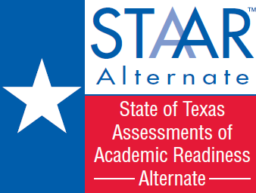

STAAR Alternate is the state assessment for students with significant cognitive disabilities.
Notes:
I wanted to start off with information about STAAR Alternate. If you are a new testing coordinator, Staar Alternate is a state assessment for our students that are the most cognitively delayed, It’s unique as it is not a paper and pencil test.

Slide 150
Assessment Window January 7th -April 19th
Monitoring Test Assignments
Check to see if any recent ARD decisions have been made that would affect how the student assignments are set up in the system
Ensure that student assessments are linked to the appropriate alternate assessment teacher in the Assessment Management System so evaluations can begin
Unregister any students no longer being assessed with STAAR Alternate and add any new students or alternate assessment teachers
Ensure that all test administrators have completed all required training before access to the Assessment Management System is provided
Have the alternate assessment teacher verify the grade level and courses!
Notes:
Important Date –Assessment Window opens on January 7th and goes through April 19th
Important Reminders from TEA especially if you are new at this:
Check to see if the ARD committee has made any recent changes that you need to be made aware of
Add new students or teachers
Make sure test administers have passed modules and had the required training before access is granted to Assessment Management System
1.

Slide 151
New Feature:
When a registered student’s records are moved to another district due to a student transfer, an email will be sent to the District Testing Coordinator at the previous district.
To the District Testing Coordinator Addressed:
This email is to inform you that a STAAR Alternate test assignment for a student has been moved from your district. No further action is needed from you at this time.
Student Name: First Last
Campus: Example School
If you have questions about this email or believe that you received this email in error, please contact Pearson's Austin Operations Center at TxPearsonAccess@support.pearson.com or via phone at 800-627-0225 Monday through Friday, 7:30 AM to 5:30 PM (CT).
Access http://www.TexasAssessment.com/support for additional help.
The transfer cut off date is March 29, 2013. Districts do not have to begin or complete an assessment after that date.
Notes:
A New Feature: Something that hopefully will be helpful to you:
When a registered student’s records are moved to another district when you have a student transfer, an email like you see on the slide will be sent to the district testing coordinator.
This year, the transfer cut off date is March 29th. From that point on, districts do not have to begin or complete an assessment after that date.

Slide 152
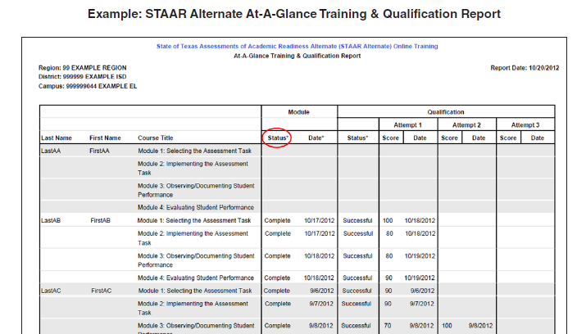
Test Administrator Training
Monitor test administrator training by verifying that …
all training modules have been completed and the qualifications passed with 80% accuracy
supplemental support is provided before the third attempt is given to the teacher
supervision is occurring for any test administrator that has not passed all the modules but is continuing to implement the assessment
Check to verify the training
status of all test administrators on the TrainingCenter by viewing the STAAR Alternate
At-A-Glance Training & Qualification Report
Notes:
On monitoring test administrator training do this by:
1. verify that all training modules have been completed and qualifications have been passed with 80% acuracy.
2. supplemental support is provided before third attempt, in other words, after two attempts

Slide 153
Growth Measure
The range of available points for STAAR Alternate (0-84)will be divided into stages that will be applied to the student’s performance.
When two years of results are available, the growth measure will compare the two years of results to determine if growth occurred between the stages.
Positive growth between stages will be factored into AYP calculations.
An adjusted cut score for satisfactory performance for the
2012 administration will be applied to the January results.
The final cut scores will reflect the standard that will be applied
to raw scores for the 2013 administration reported in May.
Adjusted Cut Scores
Notes:
Growth Measure hasn’t been developed yet or when and How but this is what TEA shared with us:
There will be a range of points between 0-84.
After 2 years of data, the growth measure will compare the results and see if growth did occur
Positive growth will be factored in to AYP/

Slide 154

STAAR Modified
Notes:
Not many changes to the STAAR Modified:
1. 2012-2013 school year-

Slide 155
What is STAAR Modified and who is it for?
An alternate assessment based on modified academic achievement standards
  Different passing standard than STAAR
  Test questions that are based on STAAR
For students receiving special education services who meet participation requirements
  For the 2012-2013 school year, applies to students in grades 3-8 and entering grades 9 and 10
    Students repeating grade 10 and in grades 11-12 are still held to the requirements of the TAKS program
Notes:
STAAR Modified is our other alternate assessment:
1. For this school year, students in grades 3-8 and those entering grades 9 and 10 will take this assessment
2. All others will take TAKS

Slide 156
GRADE/COURSE | SUBJECTS ASSESSED WITH STAAR MODIFIED IN SPRING 2013
3 | reading, mathematics
4 | reading, mathematics, writing
5 | reading, mathematics, science
6 | reading, mathematics
7 | reading, mathematics, writing
8 | reading, mathematics, science, social studies
End-of-Course (EOC) | English I, English II
 | Algebra I, Geometry
 | Biology
 | World Geography, World History
Notes:
Here is the list of test for each grade level and end of course.

Slide 157
What subjects are assessed with STAAR but are not assessed with STAAR Modified?
STAAR Modified English III and U.S. History will be administered in 2014
Algebra II, chemistry, and physics will NOT be assessed with STAAR Modified.
Notes:
What subjects are assesed with STAAR but not STAAR Modified?
1. English III and US History won’t be assessed until 2014
2. Algebra II, Chemistry, and Physics will not be assessed with STAAR and no plans to do so.

Slide 158
How have the test designs for STAAR Modified grades 4 & 7 Writing changed?
For the Spring 2012 administration, these writing tests included the revising section and a prompt on day one and the editing section and a prompt on day two.
For the Spring 2013 administration, revising and editing passages will be administered on both day one and day two.
In addition, the answer document will now be separated into day one and day two sections.
Notes:
TEA made some good changes with test design for grades 4 & 7 that you will want to share with your districts:
For the Spring administration, revising and editing will be administered on both day one and day two of testing.
Second change, the answer document will be separated into day one and day two,

Slide 159
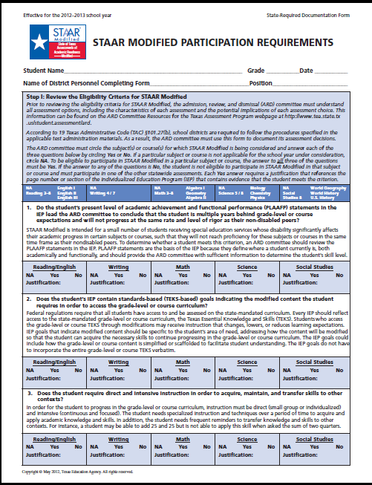
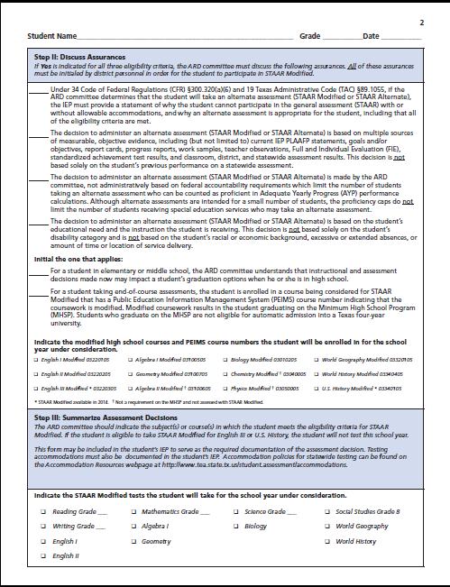
Notes:
The STAAR Modified Participation Requirements have been updated

Slide 160
What does “State-required Documentation Form” mean?
TEA requires the STAAR Modified Participation Requirements Form to be completed and retained by the district.
2012-2013: STAAR Modified Participation Requirements may be included in the student’s IEP.
2013-2014: STAAR Modified Participations Requirements must be included in the student’s IEP.
Notes:
Important updates to share with district personel:
These Participation Requirements forms must be completed and kept by the district.
For 2012-2013, they may be included in the students IEP
Beginning in 2013-2014, the form must be included in the student’s IEP

Slide 161
If a student takes STAAR Modified in high school but is dismissed from special education before graduation, will the student now have to take STAAR?
Yes. The student is now held to the same requirements as all other general education students.
Notes:
I have received this question before: read slide

Slide 162

Notes:
Good news is that TEA has made the changes and let the districts know of the changes early this year.
And .. There aren’t a lot of changes, mainly clarifications and updates.

Slide 163
Where do we look for accommodation information for TAKS, TAKS Accommodated, & TAKS-M?
Accommodation information for students who are assessed with TAKS is located in the 2010-2011 Accommodations Manual.
Additional resources for TAKS accommodations are located at http://www.tea.state.tx.us/student.assessment/taks/accommodations/

Slide 164
What students are eligible for accommodations?
Applies to students taking STAAR, STAAR Spanish, STAAR Modified, STAAR L, and TELPAS
For purposes of statewide assessments, a student needing accommodations due to a disability includes
  a student with an identified disability who receives special education services and meets established eligibility criteria for certain accommodations
  a student with an identified disability who receives Section 504 services and meets established eligibility criteria for certain accommodations
  a student with a disabling condition who does not receive special education or Section 504 services but meets established eligibility criteria for certain accommodations
Notes:
What students are eligible to use accommodations on their state assessments. Theres really no change on any of this. There must be documentation before using on state assessment.
They can be used on any state assessment
Can be sued by any of the following group of students:

Slide 165
The Accommodation Triangle
Type 2
Type 3
Type 1
Notes:
Handout---Accommodation Triangle has been updated. At your table, you will find at least one copy of our Region 17 Accommodation Triangle that I have put into a packet that can be run off of my AGC webpage. TEA stated at one of their TETN that their original intention was to post the information in the triangle on their webpage and for districts to run off a hard copy and distribute to the school personnel that need this information. Last year, districts complained about having to go look things up on their website.

Slide 166
Accommodation Resources
Region 17 Accommodation Triangle Packet
Region 1 Accommodations-At a Glance Chart

Slide 167
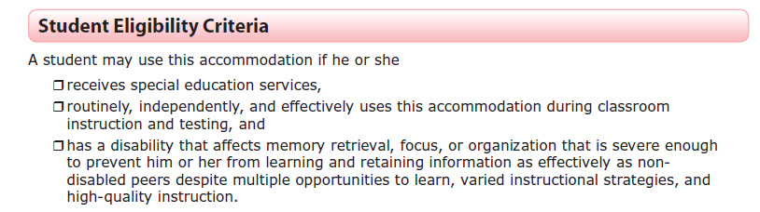
What is an example of eligibility criteria for a Type 2 Accommodation?
Supplemental Aid example– the student must meet all of the criteria

Slide 168
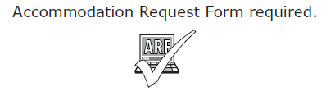
What are Type 3 Accommodations?
Only for a very small number of students
Student must meet all eligibility criteria listed
Appropriate team of people at campus level determines eligibility for listed accommodations or “other” accommodations not listed in the triangle
Requires the approval of an Accommodation Request Form (ARF) from TEA
3

Slide 169
What are Type 3 Accommodations?
Requires an approved ARF because Type 3 accommodations involve a test administrator handling or manipulating secure test materials or student responses in ways that could compromise test security, confidentiality, and/or student results.
TEA provides specific guidelines with an approved ARF in order to ensure
that Type 3 accommodations are
carried out in a standardized
manner.
3

Slide 170
Accommodation Request Process
How do we request
Type 3 Accommodations?
“Accommodation Request Process” document outlining the process for requesting Type 3 accommodations is posted on the Accommodations for Students with Disabilities webpage.
A link to the updated online Accommodation Request Form is included.
Districts must indicate that a student has met each of the listed eligibility criteria PLUS answer specific questions that detail evidence of student need.

Slide 171
How do we request
Type 3 Accommodations?
Describe the impairment in vision or physically disabling condition that creates a need for a Complex Transcribing accommodation. Be specific about the characteristics of the condition, symptoms, and level of severity the student experiences. The description should be specific and individualized. Include specific reasons why the student is not able to write his or her own compositions or use Basic Transcribing (e.g., word processor, speech-to-text software) to complete the written composition.
Attach a sample of the student’s handwriting if legibility is the issue.
Specific questions are now included on the online system to help districts complete the rationale section for Type 3 Accommodations. This information must be provided in the rationale section of the online Accommodation Request Form.

Slide 172
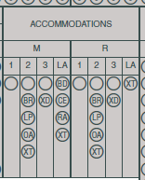
How do we
document accommodations?
“Guidelines for Recording Accommodation Use on the Student's Answer Document” is posted on the Accommodations for Students with Disabilities webpage.
Mark Type 1, Type 2, and/or Type 3 accommodations in the blank bubbles for each subject.
Mark the accommodation type for each accommodation that is documented and made available to a student, even if the student did not use the accommodation during testing.

Slide 173
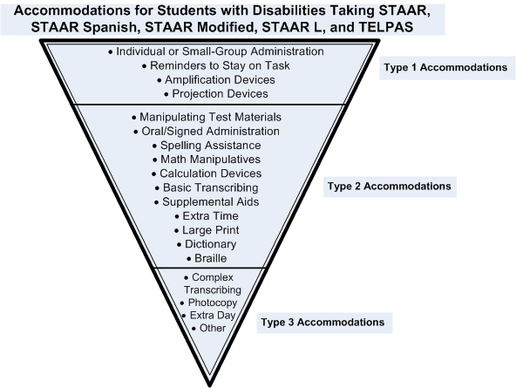
What are “OTHER” Accommodations?
Any accommodation that is not listed in the triangle can be considered if the student needs it to access the test. Other accommodations can not be requested through the online system. Districts must contact TEA to discuss when the use of an “Other” accommodation is appropriate.

Slide 174
How do we determine appropriate accommodations in unexpected or emergency situations?
Unexpected or emergency situations may occur just prior to or on the day of the statewide assessment that necessitate the use of a testing accommodation.
In these cases, testing coordinators should
  First, review Optional Test Administration Procedures and Materials to see if anything can meet student’s needs → if so, use it… no need to contact TEA
  Then, review Accommodation Triangle to see if a Type 1 or 2 accommodation can meet student’s needs → if so, use it… no need to contact TEA
  Finally, review Type 3 accommodations → if one of these will be effective, immediately contact TEA’s Accommodations Task Force for permission and additional instructions

Slide 175
How do we determine appropriate accommodations in unexpected or emergency situations?
  Encouraging student independence should be a priority
Example Scenarios
  Student arrives at school without prescribed eyeglasses → try a Projection Device or Large Print before an Oral Administration
  Student arrives at school with dominant arm broken → see if student can write math computations on a white board with non-dominant hand (“scratch paper or another workspace” in Optional document) and dictate responses for the test administrator to transcribe (Basic Transcribing) before requesting Type 3 accommodation-Mathematics Scribe

Slide 176
How should students be grouped for an
Oral Administration?
Consider
  level of reading support
  pace at which students work
  number of students one test administrator can handle
Plan for mixtures of support level and pace
  know what level of support each student receives
  remember the four-hour time limit
  move around room and read aloud to students individually or to small groups of students working at a similar pace

Slide 177


What may be read aloud during an
Oral Administration?
 | Yes | No
Math, Science, Social Studies | Test questions and answer choices (i.e., everything in the test booklet Required reference materials (as applicable) Allowable Supplemental Aids | N/A
Reading | Test questions and answer choices Required reference materials (as applicable) Allowable Supplemental Aids | Reading selections
Writing | Required reference materials (as applicable) Allowable Supplemental Aids | Revising and editing passages Revising and editing test questions and answer choices

Slide 178
What does the phrase “evidence of reading difficulty” mean?
Evidence of reading difficulty = a problem with reading
  The problem could be caused by a learning disability in reading
  The problem could be caused by other conditions, for example
    ADHD
    emotional or behavioral disability
    processing or memory issue
The ARD or Section 504 committee decides if the student exhibits evidence of a reading difficulty.

Slide 179
What does the phrase “disability that affects math calculation” mean?
Disability that affects math calculation= a problem with calculations in mathematics
  The problem could be caused by a learning disability in mathematics
  The problem could be caused by other conditions, for example
    ADHD
    emotional or behavioral disability
    processing or memory issue
The ARD or Section 504 committee decides if the student exhibits a disability that affects math calculation.

Slide 180
What are Special Instructions/Considerations for Transcribing?
Special features that should be disabled when transcribing for a student using technology-based methods (e.g., word processor, software)
  Disable internet access
    For example, an eligible student may use a tablet (i.e., iPad) to type responses, but the Wi-Fi/3G/4G internet access must be disabled and the student must be closely monitored to ensure that the internet cannot be accessed or the camera feature is not used. The student may need to complete the test in a separate setting to ensure the confidentiality of the test.
  Disable spell check, word predictor, and all other special features (unless the student also meets the eligibility criteria for Spelling Assistance)
When transcribing a student’s responses to griddable questions, don’t forget that the test administrator MUST use the “Transcribing Griddable Questions” document so that the student is aware of the maximum number of boxes available for each answer.

Slide 181
What are Special Instructions/Considerations for Transcribing?
When transcribing a student’s responses to the writing prompts and/or the short-answer reading questions, the test administrator must indicate to the student the space allowed.
  26 lines for each written composition
  10 lines for each short-answer reading question
What are some ways the test administrator can indicate to the student the space allowed?
  The test administrator or student can use a piece of scratch paper with the correct number of lines or a sample lined page from the answer document (on TEA website) prior to having the response copied to the answer document.
  Twenty-six lines of handwritten text is approximately 1,725 typed characters. Ten lines of handwritten text is approximately 675 typed characters. These numbers are based on average-sized handwriting.

Slide 182
How many large-print booklets can a district order?
Large-print materials should only be ordered for students who meet the eligibility criteria.
Districts who order excessive numbers of large-print materials will be flagged for review.

Slide 183
STAAR Optional Test Administration
Procedures and Materials
Allowed for any student who needs them, not necessarily every student
Students must have a need and have previously used in the classroom
Use on test is not recorded on the answer document
Documentation is not required beyond what is necessary for planning on testing day
The Optional Test Administration Procedures & Materials document is located in the following places:
  2013 District and Campus Coordinator Manual
  District and Campus Coordinator Manual Resources webpage
  STAAR Test Administrator Manuals
  Accommodation Resources webpage
Notes:
Display outside Main Hall

Slide 184
What procedures and materials are available to ALL students?
Preferential seating
Special lighting conditions
Signing or translating test administration directions
Reading the test aloud to self
Reading aloud or signing the personal narrative, expository, literary, or persuasive writing prompt
Handout
Reading assistance on the
grade 3 mathematics test
Scratch paper or other material to use as workspace
Minimizing distractions
Colored overlays
Magnifying devices
Blank place markers
Highlighters, colored pencils, or crayons

Slide 185
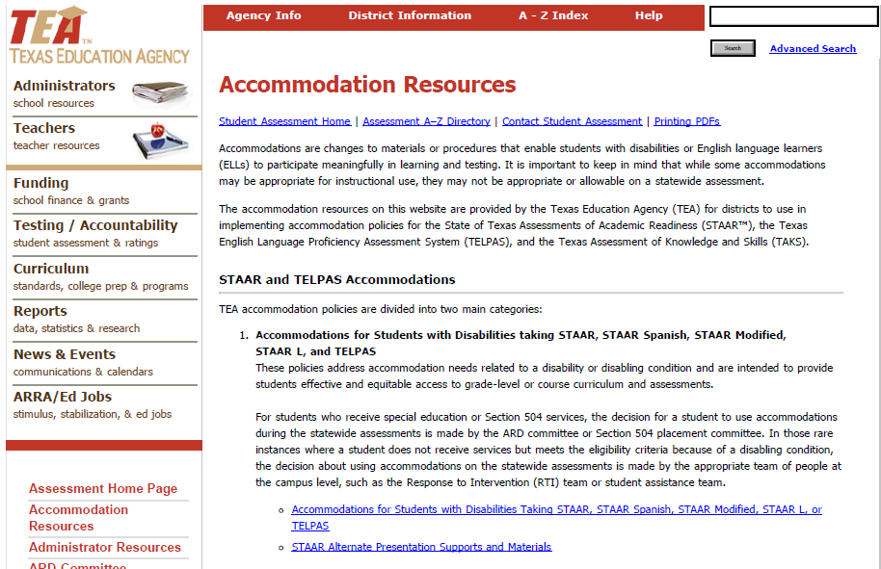
http://www.tea.state.tx.us/student.
assessment/accommodations/
Click this link to see all resources for accommodations for students with disabilities

Slide 186
Access to General Curriculum Webpage:
* www.esc17.net
* Menu on left side-Choose Diverse Learners
* Then Choose- AGC
* Scroll down to TEA and ESC Resources:
1. New-Optional Test Administration Procedures
and Materials Document
2. New- Region 1 Accommodations- At-a Glance
Chart
3. Updated-Region 17 Accommodation Triangle
Packet

Slide 187


Slide 188
Components of the 2013 Texas Assessment Program
State of Texas Assessments of Academic Readiness (STAAR)
  STAAR Spanish
  STAAR L
  STAAR Modified
  STAAR Alternate
TAKS and TAKS–M (grade 11/exit level)
Texas English Language Proficiency Assessment System (TELPAS)

Slide 189
Answer Documents
STAAR and STAAR Spanish — one combined answer document
STAAR L is online
STAAR Modified — separate answer document
STAAR Alternate — no answer documents should be submitted for students assessed with STAAR Alternate

Slide 190
Answer Documents (continued)
STAAR L is NOT available for the subjects/programs listed below:
    Reading, Writing, English I, English II, and English III
    STAAR Spanish
    STAAR Modified

Slide 191
Answer Documents (continued)
TELPAS — no answer documents
TAKS and TAKS–M — no changes from last year

Slide 192
Answer Documents (continued)
Less score codes in STAAR!
  “S” – tested
  “A” – absent
  “O” – other (illness, testing irregularity, EOC/above grade level, etc.)
  “*” – paper/online or STAAR/STAAR Modified
  SSI score codes – “P,” “R,” “PW”
NOTE: For each subject area, only ONE score code should be gridded.

Slide 193
Answer Documents (continued)
An “*” score code is present on all STAAR and STAAR Modified answer documents that have two subject areas tested (except STAAR Modified English I and II).
NOTE: For each subject area, only ONE score code should be gridded.

Slide 194
Answer Documents (cont.)
TEST TAKEN INFO field — information about the language version (English or Spanish) must be recorded in this field.
    “EN” or “SP” for grades 3, 4, and 5

Slide 195
Answer Documents (continued)
For each subject area tested, only ONE bubble, if applicable, should be gridded in the TEST TAKEN INFO field to show which assessment the student was administered.
  Determine the language version of the assessment that the student will take (grades 3, 4, and 5 only).
  Follow the same steps to grid the TEST TAKEN INFO field even if the student is absent from the test or illness/test irregularity occurs during testing.

Slide 196
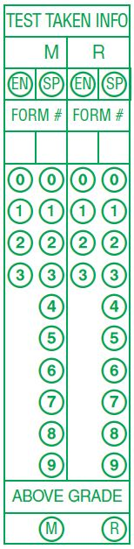
Answer Documents (continued)
STAAR
(English and Spanish)

Slide 197
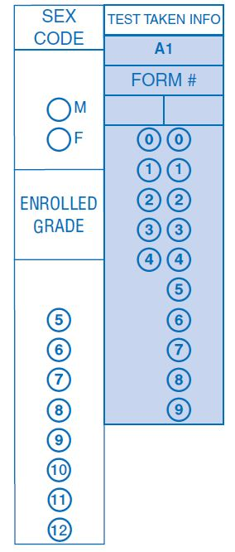
Answer Documents (continued)
STAAR
EOC

Slide 198
Answer Documents (continued)
Foreign Exchange Students
  Required to test
  No bubble on the Spring 2013 answer documents
  Gridding of Agency Use field

Slide 199
Answer Documents (continued)
Minimum Score vs. Level II
  Graduation requirements
  Testing requirements
  Answer documents – Absent/Other/Void

Slide 200
STAAR Precoding
Precoded labels – English I, II, III, Modified, and grade 4 and 7 writing
Precoded answer documents – STAAR EOC (mathematics, science and social studies) and grades 3–8 reading, mathematics, science, and social studies

Slide 201
Precoding (Continued)
Districts can receive two precoded answer documents (when appropriate) for students testing above grade.
  Example: A student will take grade 6 reading and grade 7 mathematics. Submit a record in the precode file with the grade as ‘06’ and a value of ‘07’ in the “Above Grade Code” field. Records must indicate if the student will test online or on paper
STAAR EOC Reading and Writing
  Reminder that STAAR English I, II, and III will have separate answer documents for reading and writing. Therefore you need to submit two records in the data file if the student will be taking both reading and writing in order to get two precode labels.

Slide 202
Precoding (Continued)
Beginning with May EOC we will be providing precoded answer documents for STAAR mathematics, science and social studies assessments. If the student is identified as Special Education = ‘1’, a precoded answer document and a precode label (for those subjects that have STAAR Modified) will be provided.
Reminder that we do not pull PEIMS records for EOC. Districts need to supply data if they want precode documents for students other than the supplied non-masters.

Slide 203
Precoding (Continued)
STAAR L will be given online beginning in
Spring 2013.
  In order to register the students to test online, districts will need to designate the record with an ‘L’ in the “STAAR L Version Code” when submitting a student data file. Submit only for Algebra I, Geometry, Algebra II, Biology, Chemistry, Physics, World Geography, World History, and U.S. History
  Records will also need to be designated as online in the “Test Format” for EOC.
  For grades 3–8 when a student is designated as STAAR L in the data file and one of the tests is not a STAAR L test, the student will be registered for the STAAR L test and will receive a precoded document for the non STAAR L subject (reading and mathematics assessments on the same answer document).

Slide 204
STAAR Reporting
EOC and 3–8 will have separate data files/reports
All reports will be provided online in PDF format
STAAR, STAAR Spanish, STAAR L, STAAR
Modified, and STAAR Alternate will all be reported
on the same file

Slide 205
STAAR Standard Reports
Confidential Student Reports (CSRs)
Confidential Student Labels
Confidential Campus Rosters
Campus and District Summary Reports—
including constructed response, phase-in, and cumulative history (grades 5 & 8 retests) summary reports
Data Files – individual student data files and cumulative history data files (EOC only)

Slide 206
STAAR Optional Reports (Formats)
CSRs – extra copy or PDF on CD-ROM
Labels – extra copy or no labels
Rosters – paper or PDF on CD-ROM
Summaries – paper or PDF on CD-ROM
Data Files – CD-ROM

Slide 207
STAAR EOC – Summary of Changes
  The Phase-In 2 standard will be added to the Level II Phase-In Summary Report.
  A Level III Phase-In Summary Report will be added for STAAR Algebra II, English III reading and writing, and STAAR L Algebra II.

Slide 208
STAAR EOC – Summary of Changes (continued)
Reporting for “Progress Towards Graduation” will be available in the student portal in spring 2013.
Enhancements to “Progress Towards Graduation” reporting as well as information available to campuses will be provided after the legislature convenes in 2013.

Slide 209
Changes to Summary Reports for STAAR EOC and STAAR 3–8
  Program information groups will be changed for the following. Disaggregation can still occur by using the analytic reporting tool.
    Economically Disadvantaged (Yes/No)
    Title I, Part A (Participants/Nonparticipants)
    Bilingual (Participants/Nonparticipants)
    ESL (Participants/Nonparticipants)
    Career/Technical Education (Participants/Nonparticipants)

Slide 210
EOC Reporting – CSRs
One page per subject
Includes explanatory text (no parent brochures)
PDF online
Paper copies shipped to district (two copies per student)
Same data will be available in the student portal

Slide 211
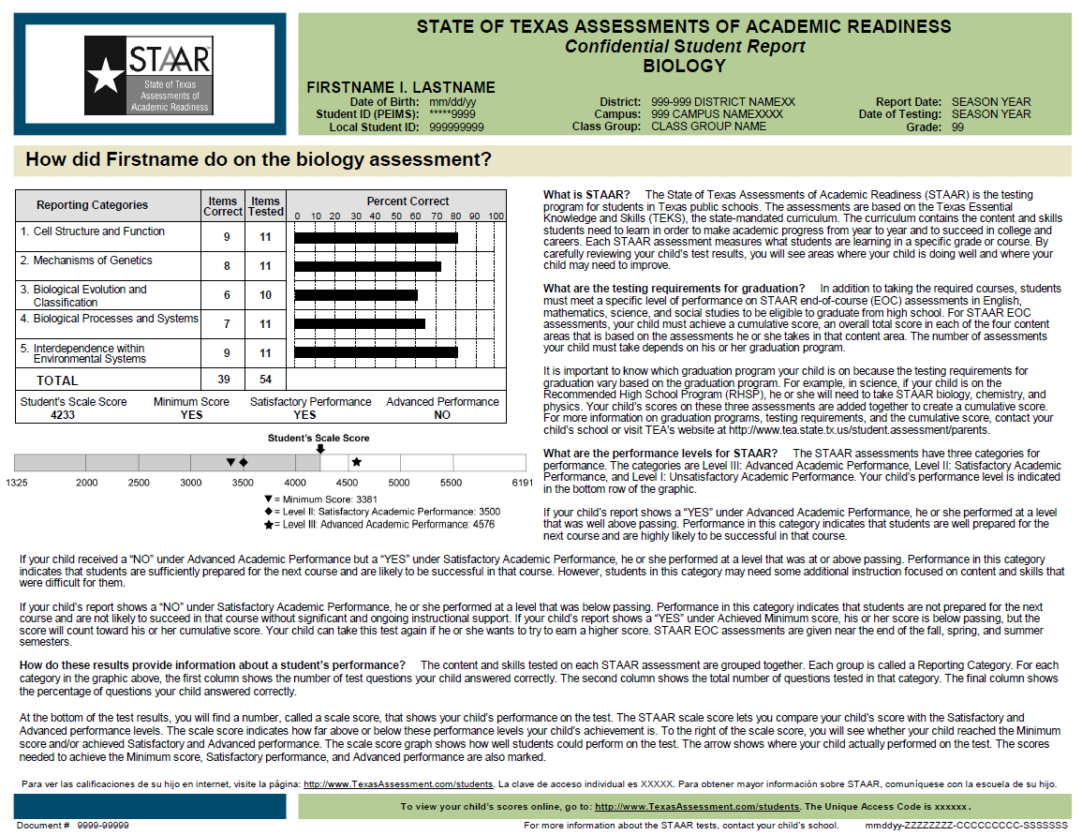

Slide 212
EOC Reporting – Labels
Will provide current administration results
Up to eight rows (one row per assessment)
per label
Students will have two labels if taking
more than eight assessments

Slide 213
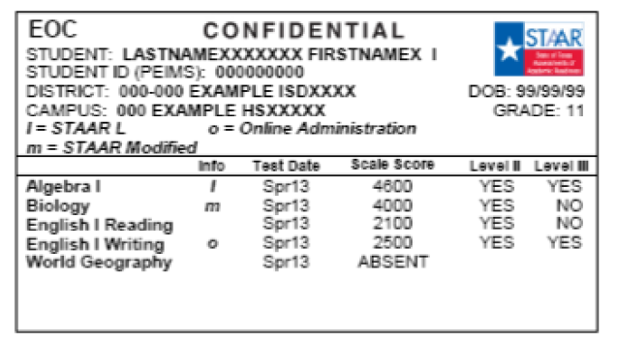
text

Slide 214
EOC Reporting – Rosters
Separate rosters for each subject
Separate rosters for STAAR, STAAR L, STAAR Modified, and STAAR Alternate
“All Students” and “Students Not Achieving Satisfactory Performance” – STAAR Modified and STAAR Alternate will not have the “Students Not Achieving Satisfactory Performance” roster
PDF online

Slide 215
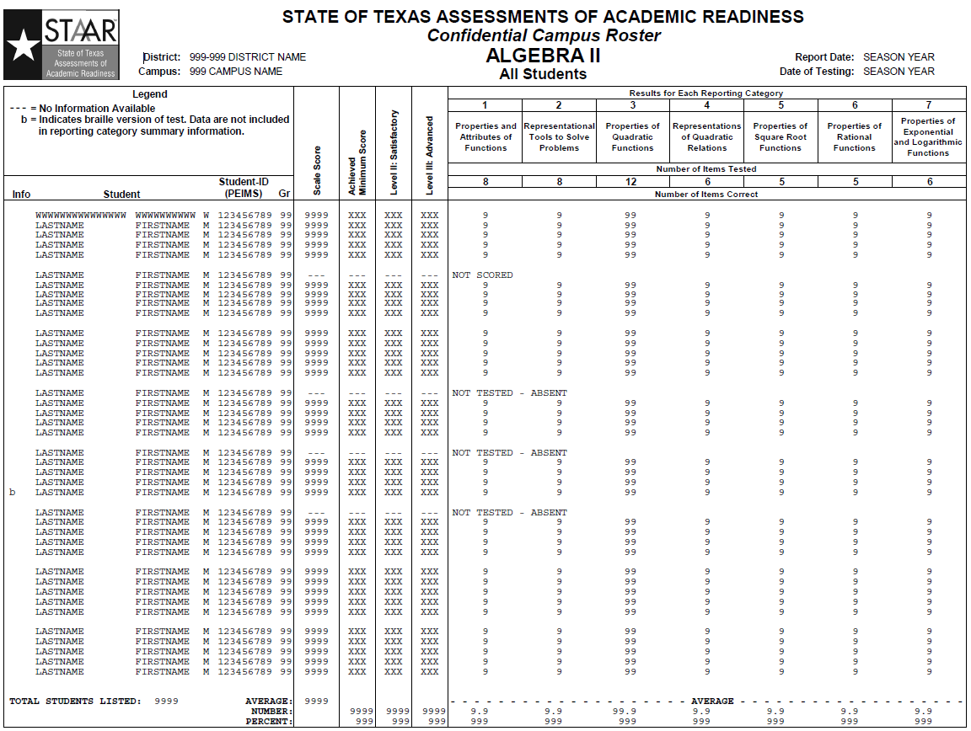

Slide 216
EOC Reporting – Summaries
One page per subject; writing, reading, and constructed responses on separate pages (English I, II, and III)
Separate summaries for STAAR, STAAR L, STAAR Modified, and STAAR Alternate
“All Students” only
PDF online

Slide 217
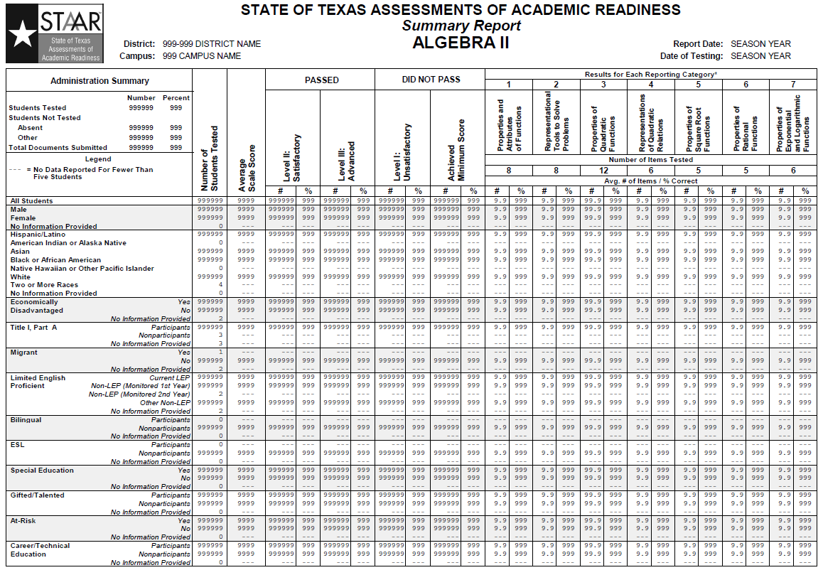

Slide 218
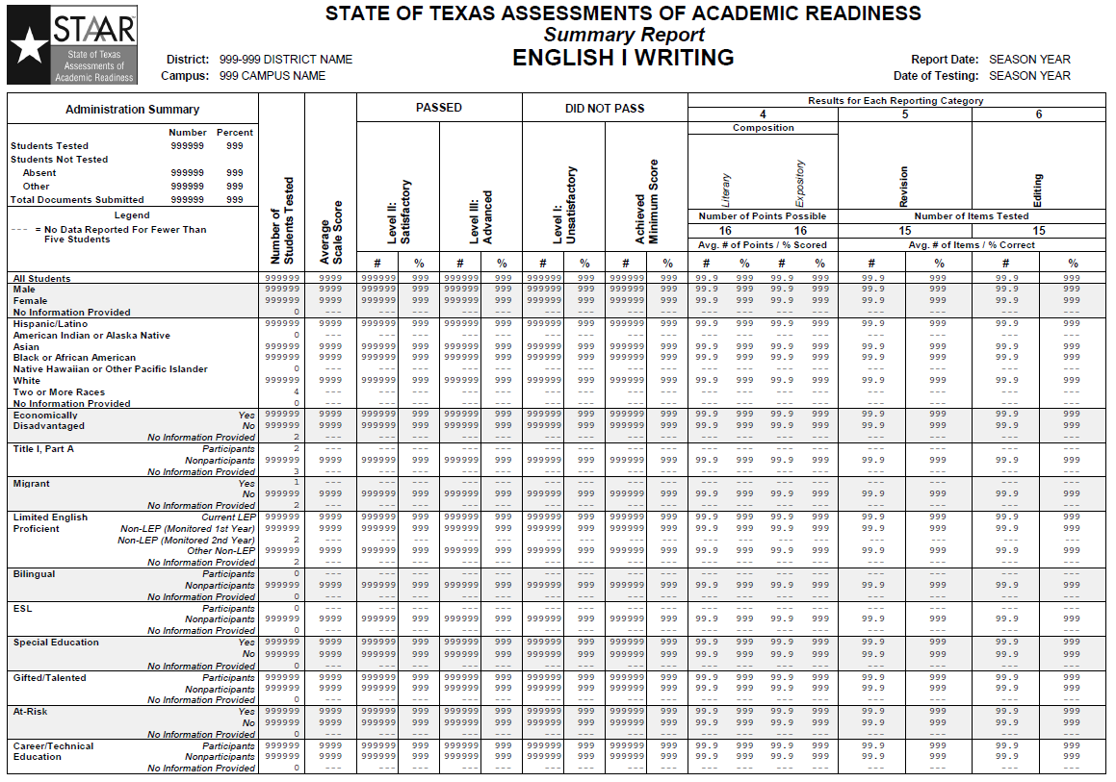

Slide 219
EOC Reporting – Summaries (continued)
Constructed Responses Summary (English I, II, and III)
    One page for reading showing the distribution of score points for the reading open-ended items
    One page for writing showing the distribution of score points for the written compositions

Slide 220
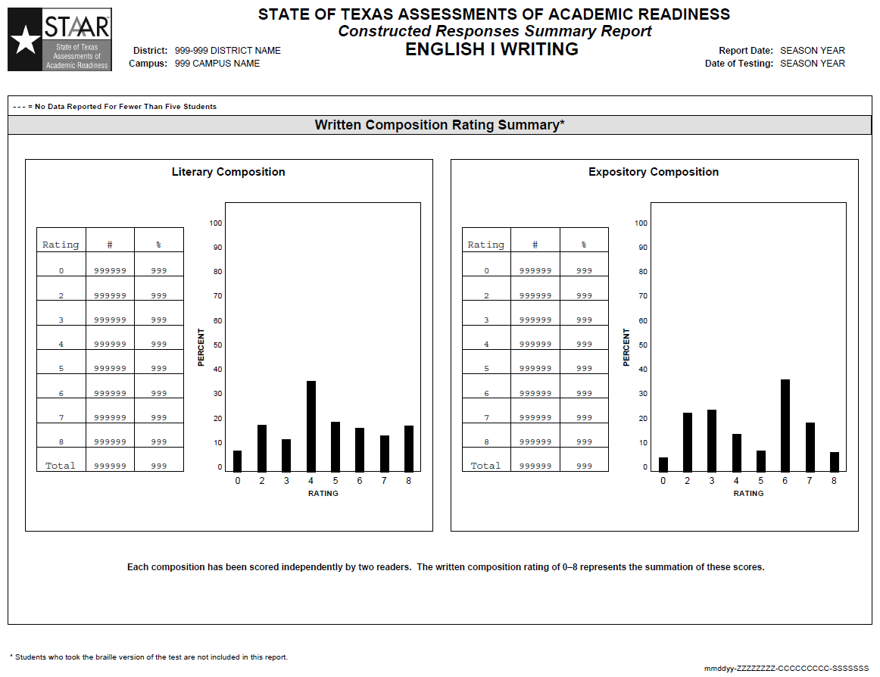

Slide 221
EOC Reporting – Summaries (continued)
Level II Phase-In Summary – one for each content area
Number and percent of students at Level II (and above) for the Phase-In 1, Phase-In 2 and Recommended Standards
One each for STAAR, STAAR L, and STAAR Modified

Slide 222
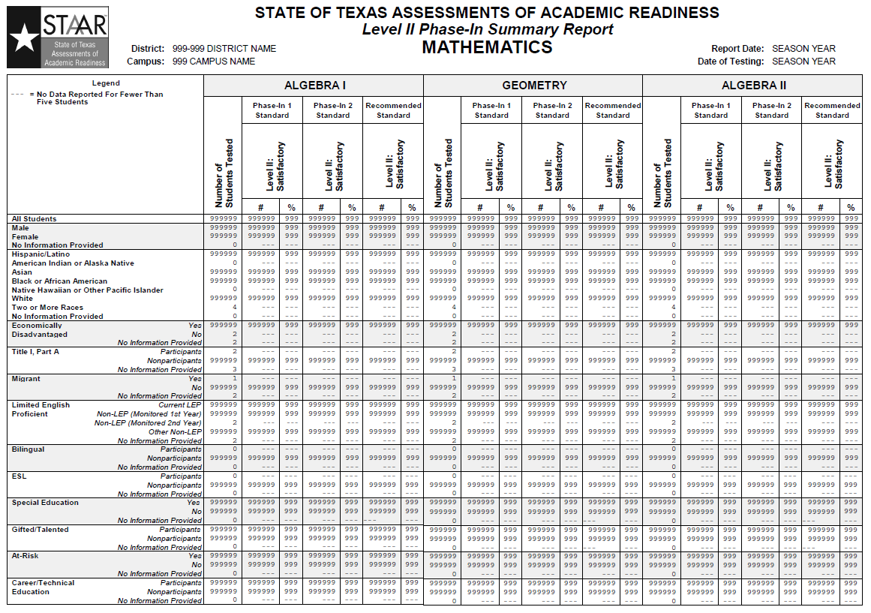

Slide 223
EOC Reporting – Summaries (continued)
Level III Phase-In Summary – one page containing information for Algebra II, English II reading, and English II writing
Number and percent of students at Level III for the Phase-In and Recommended Standards
One each for STAAR and STAAR L (STAAR L has Algebra II only)

Slide 224
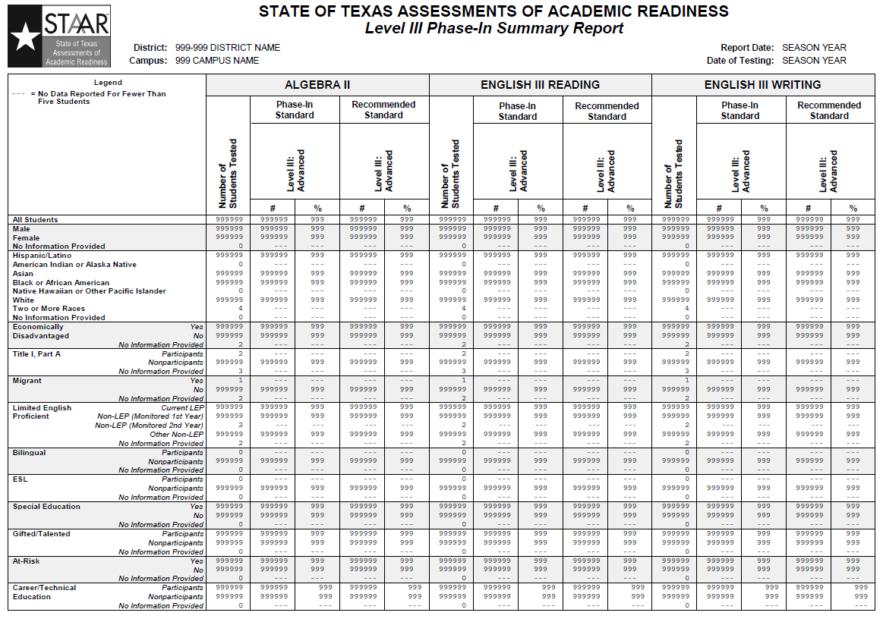

Slide 225
EOC Reporting – Data Files
Two data files for EOC
    “Administration” data file will only have information for the administration being reported – one record per student/assessment
      Will have student response information – “1” for correct items and “0” for incorrect items (for spring administration only)
      Student Expectation information will be
      posted on TEA website (for spring administration only)

Slide 226
EOC Reporting – Data Files (continued)
“Cumulative History” data file will have history
and cumulative score information
      One record per student that tested during the
      administration with information about all 15 assessments and cumulative score information for each content area

Slide 227
EOC Reporting – Data Availability
First Phase
  STAAR, STAAR L, STAAR Alternate, and all STAAR Modified except for world history will have standards set – performance levels will
  be reported
  STAAR Modified world history will NOT have standards set until summer – will only report information about which students tested for Modified

Slide 228
EOC Reporting – Data Availability
Second Phase
  Fall 2013 – after standards for STAAR Modified world history are set, CSRs and labels will be sent to districts for the STAAR Modified world history students; CSRs, rosters, summaries, and data files will be updated and posted

Slide 229
STAAR 3–8 – Summary of Changes
  The Phase-In 2 standard will be added to the
  Level II Phase-In Summary Report.
  Cumulative summary report for grades 5 & 8 reading and mathematics retests.

Slide 230
3–8 Reporting – CSRs
PDF online
All subjects on one report
Paper copies shipped to district (two copies per student)
Parent brochures (one sheet, two pages) will be provided with the CSRs – both English and Spanish provided as was done for TAKS
Same data will be available in the
student portal

Slide 231
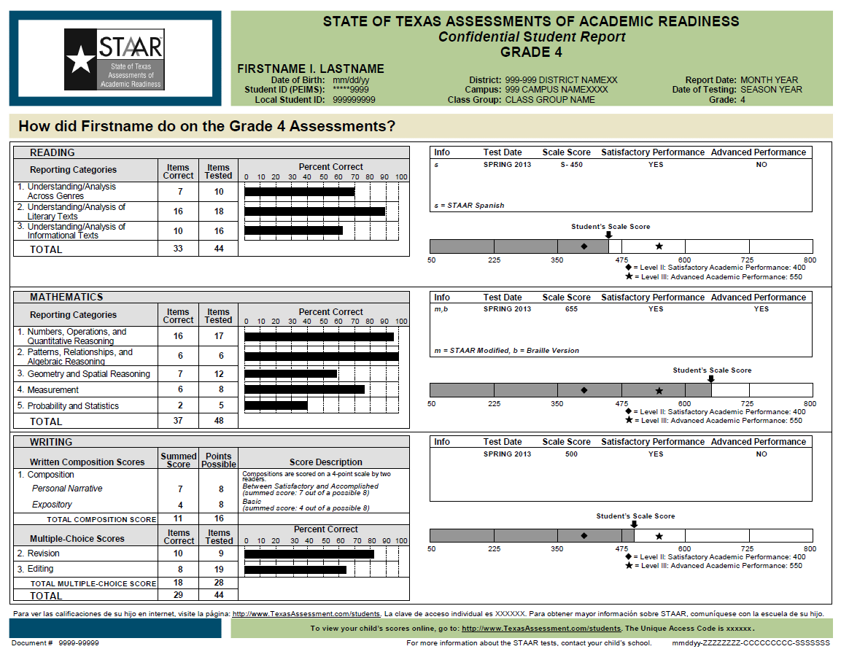

Slide 232
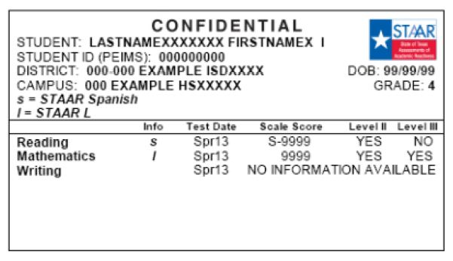
3–8 Reporting – Labels
Same format as TAKS labels
Grade 5 & 8 retest labels will have previous administration data

Slide 233
3–8 Reporting – Rosters
Separate rosters for each subject
Separate rosters for STAAR, STAAR Spanish, STAAR L, STAAR Modified, and STAAR Alternate
“All Students”
“Students Not Achieving Satisfactory Performance” (not provided for Modified or Alternate)
PDF Online

Slide 234
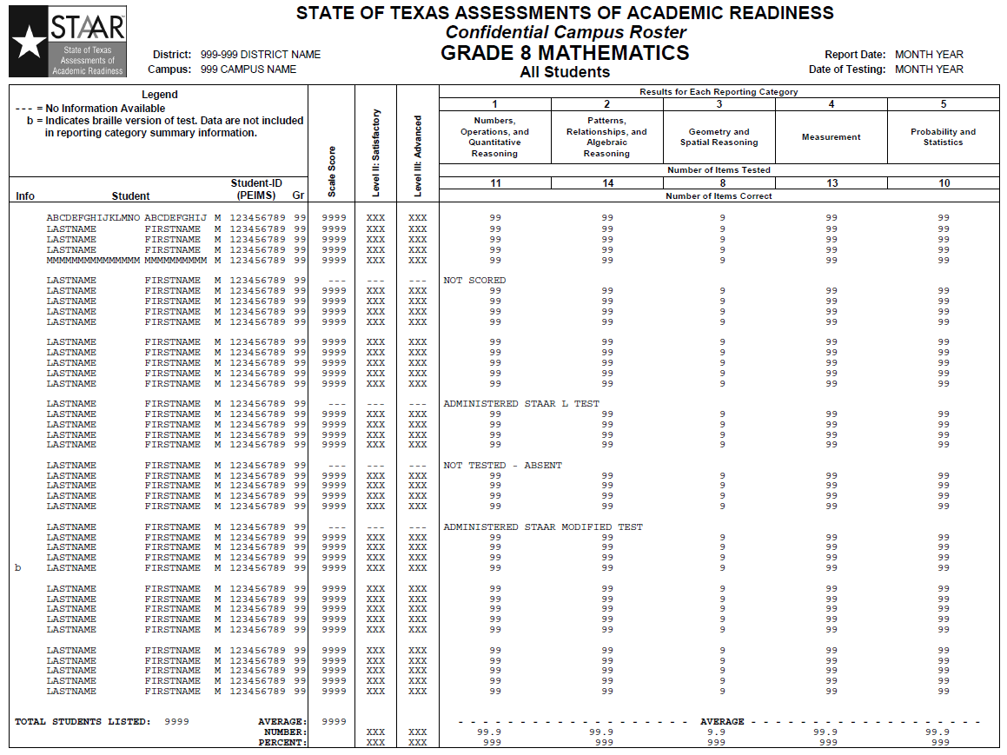

Slide 235
3–8 Reporting – Summaries
One page per subject; writing will also have a constructed responses page
Separate summaries for STAAR, STAAR Spanish, STAAR L, STAAR Modified, and
STAAR Alternate
“All Students” Only
PDF Online

Slide 236
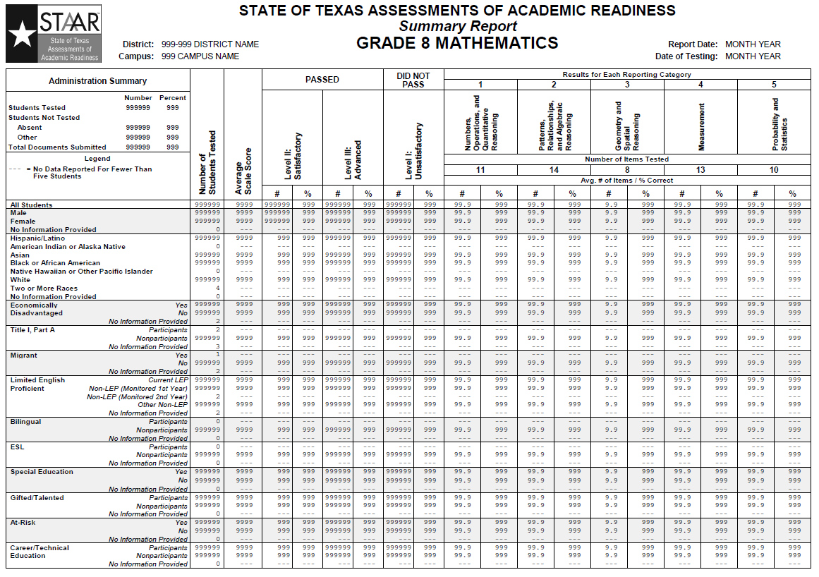

Slide 237
3–8 Reporting – Summaries (continued)
Phase-In Summary – one for each grade
Number and percent of students at Level II
(and above) for the Phase-in 1, Phase-In 2 and Recommended Standards for each subject
One each for STAAR, STAAR Spanish,
STAAR L, and STAAR Modified

Slide 238
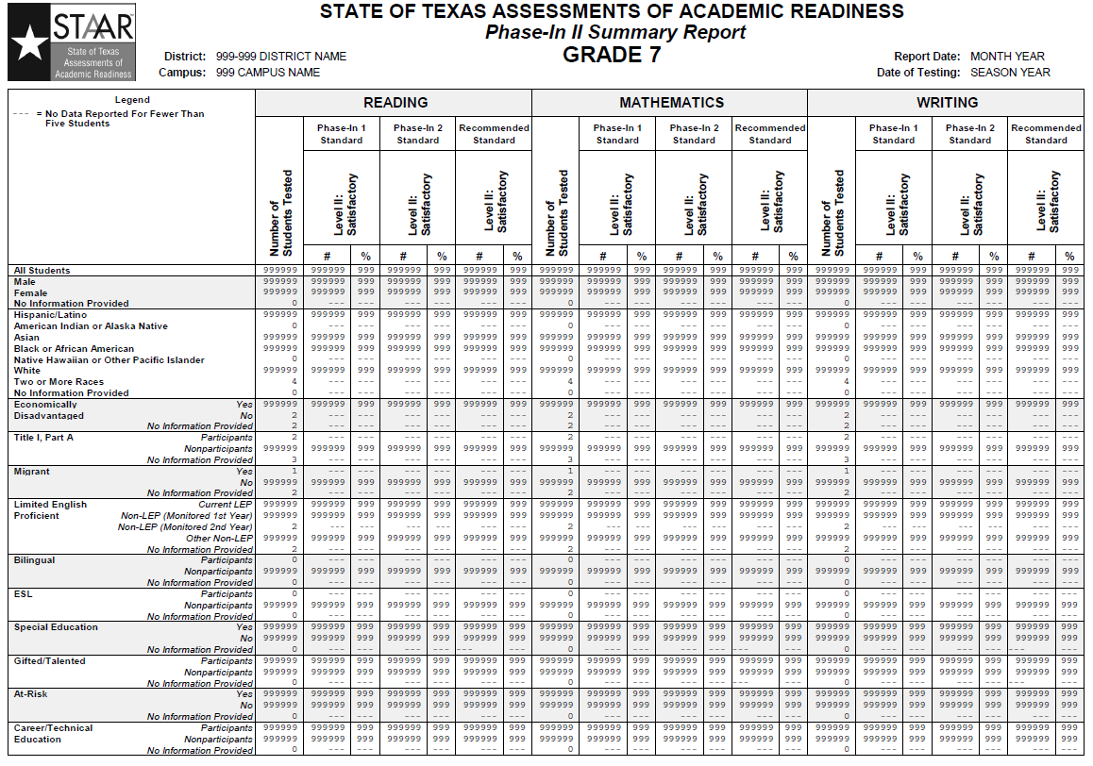

Slide 239
3–8 Reporting – Summaries (continued)
  Cumulative Summary Report
    Provided for the May and June Grades 5 & 8 Retests
    One for each subject
    English and Spanish are combined for grade 5
    STAAR L, STAAR Modified, and STAAR Alternate are not included in the Cumulative Summary Report

Slide 240


Slide 241
3–8 Reporting – Data File
One data file for each administration for STAAR 3–8 (same format for each administration)
    Will have student response information – “1” for correct items and “0” for incorrect items for primary administrations; not provided for STAAR L, STAAR Modified, or Braille
    Student Expectation information will be posted on TEA website
    Will contain previous year history information

Slide 242
Test Taken Information Changes, Score Code Changes, and Student Test Warnings
(Record Changes)
The same update process as last year will be used. Updates will be made through the Texas Assessment Management System for STAAR and through SchoolHouse for TAKS and TELPAS.
  Updated CSRs and data files will be provided online

Slide 243
TAKS and TELPAS
Same reports will be offered as in previous years

Slide 244


Slide 246
    Minimum System Requirements
    Updates to Proctor Caching
    Updates to Configure TestNav
    Setting Up Your Infrastructure
    System Check Utility
    Resources

Slide 247

Minimum System Requirements: The Minimum System Requirements pdf have been updated for 2012–2013 and is posted at the following location: http://www.TexasAssessment.com/reqs
Updates include:
  Support for Chrome
    For Mac OS X 10.5, the Chrome browser must be earlier than
    Chrome 21.
    Mac OS X 10.7 and 10.8 users who install the Java for OS X 2012-006 update from Apple will not be able to use the Chrome browser because these Mac OS and Java updates are 64 bit and Chrome is still 32 bit.

Slide 248
Proctor Caching: Proctor Caching has been upgraded. The update has increased performance on Windows and Mac operating systems. You can still use the previous version of Proctor Caching, but you can’t take advantage of the performance benefits of the new version.
The latest version of Proctor Caching for PC and Mac computers can be found at http://www.TexasAssessment.com/downloads or from within the Assessment Management System at Support>Resources>Downloads.
For information about Proctor Caching and the steps involved in pre-caching test content refer to the TestNav 7 Combined Technical Guide located at http://www.TexasAssessment.com/techinfo or from within the Assessment Management System at Support>Resources>Technology Information.

Slide 249
Configure TestNav: TestNav configurations in the Assessment Management System were updated to support the updates made to the Proctor Caching software. TestNav configurations are now applied at the test session level instead of at the student level.
Every student in a test session will use the configuration set for that session. If changes are made to the configuration, the session and the students in the session are automatically updated with those changes.
NOTE: If you need one or more students to have settings that are different from those defined in the organization-based configuration, you must place the student or students into a new session and create a custom configuration for that session.
Review the “Configure TestNav” section of the User’s Guide for the Texas Assessment Management System at http://www.TexasAssessment.com/guide to ensure your test sessions are configured correctly.

Slide 250


Configure TestNav: The district coordinator can view and edit the TestNav settings for the session from the test Session Details screen.
Additionally they can edit, make default and delete the TestNav Settings from the Configure Details screen in Configure TestNav.

Slide 251
System Infrastructure: Hardware, Operating System, and Web Browser Recommendations - The following programs are required for online testing:
Adobe Flash Player 10.0 or higher must be installed on administrative computers in order to view the TestNav 7 tutorial via a browser (http://get.adobe.com/flashplayer).
Java 1.5 or higher must be installed in order to use browser-based TestNav 7.
The minimum and recommended technical requirements for all computers accessing the Assessment Management System and TestNav 7 are available as a separate document at http://www.TexasAssessment.com/reqs or from within the Assessment Management System at Support >Resources >Technology Information.

Slide 252

System Infrastructure: The online System Check utility for TestNav 7 is designed to help technology personnel identify whether the infrastructure is ready for online testing prior to scheduled testing dates. Network infrastructure readiness is a key component in assessing and planning for online testing.
http://www.TexasAssessment.com/SystemCheck
The TestNav tab checks to
make sure the computer
meets the minimum software
requirements to deliver tests
online.

Slide 253


System Infrastructure: The online System Check utility - The Network User Capacity tab provides a data throughput check that assesses both the data transfer speeds and the estimated number of concurrent testers that could be supported for a given test if testing were to occur at the same moment the system check test is run. This result, however, may not accurately represent the constraints that may exist when testing actually occurs, especially if network conditions will be significantly different from their state
when the system check
test is run.
This diagnostic tool should
be run at the peak time of
network utilization in the
day in order to obtain the
most accurate results.

Slide 254


System Infrastructure: The online System Check utility - The Testing Volume Calculator tab provides a tool for modeling and calculating the anticipated throughput and student testing volumes planned for a scheduled date of testing. Since the calculation is based on network speed and expected utilization,
this is a purely
theoretical calculation
used for capacity
planning.

Slide 255
Resources: Manuals and Guides
  User's Guide for the Texas Assessment Management System
  Unified Texas Minimum System Requirements
  PearsonAccess Overview Training Modules
  TestNav 7 Combined Technical Guide
  TestNav 7 and Proctor Caching Quick Start
  Tips for TestNav 7: Adobe Flash Player and Java
  TestNav 7 32/64 Bit Browser Configuration (New!)
  2012 District and Campus Coordinator Manual
These and additional online resources for TAKS, TELPAS, and STAAR EOC can be found at http://www.TexasAssessment.com/resources or from within the Assessment Management System at Support >Resources.

Slide 256
Resources: Downloads and Links
  Proctor Caching – Mac
  Proctor Caching – PC/Windows
http://www.TexasAssessment.com/Downloads
The Texas Assessment Management System: Operational (Live) Site
  http://tx.testnav.com/TX
The Texas Assessment Management System: Practice Center
  http://tx.testnav.com/TXTRNG

Slide 257
Resources: Training
Administration/Technology Staff
  Texas Assessment Management System Practice Center
    Flash Written Composition Tool — Texas Assessment Practice Administration
    Proctor Caching Testing Tool — Texas Assessment Practice Administration
    Texas Practice Test — Texas Assessment Practice Administration
  PearsonAccess Overview Training Modules
Students – Electronic Practice Tests (ePATS)
  Texas Specific Testing Tools
  TAKS Written Composition Tool
  STARR End-of-Course Writing Tool
  STAAR End-of-Course Analytical Essay Tool
  TELPAS Online Reading Test Student Tutorials

Slide 258
Resources:
Pearson’s Austin Operations Center
7:30 AM – 5:30 PM CT Monday–Friday
Toll free: 800-627-0225 E-mail: TxPearsonAccess@support.pearson.com
Call or e-mail Pearson’s Texas Online Team for assistance with:
information about online testing or online testing procedures
navigating the Texas Assessment Management System
accessing and using the Practice Center
managing examinee data
setting up test sessions
assigning login IDs and passwords
accessing resources
questions about Pearson Online Testing communications
questions about oral administration of test sessions
setting up a test run of the TestNav test delivery system
network problems
proctor caching issues
evaluating infrastructure
hardware and software requirements or problems
the TestNav Early Warning System
wireless networking issues
technical emergencies
solving online testing set-up issues

Slide 259
Resources: Contacts
TEA
Telephone 512-463-9536 Fax 512-463-9302
TEA Student Assessment website – http://www.tea.state.tx.us/student.assessment
Call TEA’s Student Assessment Division for assistance with:
testing accommodations
requesting changes to the testing schedule
questions about the policy on taking breaks and lunch
testing beyond normal school hours
handling unusual circumstances on test days
violations of test security
handling school emergencies that affect testing
questions about general online testing policy
questions about TEA communications

Slide 261
The following are new processes and functionalities for the 2012-2013 school year:
  Roles:
    New Technology role
  Usability/Navigation:
    Test Results tab was renamed to Reports
    Support link was renamed to Resources
  STAAR Processes:
    Resolving Student Test Warnings
    Changing Score Codes and Test Taken Information
    Request Assessment History (SIRS)
  STAAR Reporting:
    Student Data Assessment tab
    STAAR added to the Data Portals

Slide 262
ROLES: The new Technology role was added this year to allow a user assigned this role to provide the technology needs for TestNav 7 configurations to support the districts online testing processes.
The Technology role has permissions to:
  View students testing and test progress
  Create and view Customer Support Requests
  Create and edit TestNav Configurations
  Set-up and manage Proctor Caching
Please see the User Roles and Permissions for the Texas Assessment Management System in Resources for a full listing of all permissions associated with this and all other roles.

Slide 263

Usability/Navigation: With the addition of the new STAAR processes that have been added to the Assessment Management System, the Test Results tab was renamed Reports.
Additionally the Support link has been renamed Resources and the resources section of the Assessment Management System has been reorganized to help with finding the information, trainings and FAQs needed.
More items are now posted to the More Recent area and training materials and FAQs have been updated.

Slide 264

STAAR Processes: There are three new process in the Reports tab to support the implementation of the STAAR program.
1
2
3

Slide 265
STAAR Processes: All three new processes on the Texas Assessment Management System, delivered through PearsonAccess, apply to STAAR administrations only.
  See the User’s Guide for the Texas Assessment Management System located at http://www.TexasAssessment.com/Manuals for additional information.
Corresponding processes for TELPAS and TAKS administrations are on the Online Data Management (SchoolHouse).
  See the Online Data Management User’s Guide located at http://www.TexasAssessment.com/Manuals for additional information.

Slide 266
  Student Test Warnings
  Terminology:
    Matching Criteria
    Test Attempt
  What Produces Student Test Warnings
    Missing Grade
    Invalid Data
    Student Information Mismatch/Suspect Students
  How to Resolve Test Warnings and Suspect Students
    Missing Grade
    Invalid Data
    Student Information Mismatch/Suspect Students
For reference, see also the Student Directory Overview document and the Student Directory and Registration Data presentation available on the Resources page at http://www.TexasAssessment.com/Techinfo.

Slide 267
Terminology
Matching Criteria
  When answer documents are processed and loaded into the Assessment Management System, they are matched to students
  in the Student Directory by PEIMS-ID.
  If the PEIMS-ID matches a student in the directory, then the following matching criteria is applied to confirm a match:
    PEIMS-ID + 2 out of 3 of LAST-NAME, FIRST-NAME,
    and DATE-OF-BIRTH = student match
Test Attempt
A completed test taken either on paper or online. (e.g., STAAR end-of-course (EOC) English I Reading) is a test attempt.
A test attempt is recorded in the Assessment Management System once the online test or paper test attempt is processed.

Slide 268
What Produces a Test Warning: Student test warnings apply only to paper tests. A test attempt that is precoded is “pre-matched” to a student in the directory and should not produce a Student Test Warning, but any changes made to the directory after precoding could result in a Student Test Warning when the test attempt is processed. There are three types of warnings that may appear as the result of processing a paper test attempt:
  Missing Grade: this warning applies to EOC only. Grade information on the test attempt not provided or invalid
  Invalid Data: PEIMS-ID, FIRST-NAME, LAST-NAME, DATE-OF-BIRTH, GRADE, and/or SEX-CODE from the test attempt contain invalid data (invalid data includes blank or double-gridded data, invalid date [February 30, future date])
  Student Information Mismatch: student information from the test attempt does not match a student in the Directory with this PEIMS-ID – this will create a Suspect Student
  Suspect Students are created when the matching criteria cannot find a matching student in the student directory in the Assessment Management System. All of these Test Warnings occur when there is an inaccuracy in the student data associated/supplied with a test attempt.

Slide 269

What Produces a Test Warning - Suspect Student: Suspect Students should be resolved from the Test Results tab> Resolve Student Test Warnings sub tab.
When selecting the Suspect Student to resolve you will be navigated
to the Student Data>Manage Student Directory.
You can also search for Suspect Students directly from the student directory by selecting “Include” radio button from the Suspect option set when getting your search results.

Slide 270

What Produces a Test Warning - Suspect Student: Search for the Suspect Student in the directory or use the Show All Students check box.
In the search results a Suspect Student will have the gridded PEIMS-ID from the test attempt listed in the Suspect column and not in the
PEIMS-ID column.

Slide 271

Resolving Student Test Warnings: Navigate to Reports>Resolve Student Test Warnings.
Click the Change link to change your current administration to the desired STAAR administration.

Slide 272

Resolving Student Test Warnings: There can be multiple warnings for a single answer document. These warnings can be resolved in any order, and will no longer appear in the search results when completed.

Slide 273


Resolving Student Test Warnings: The different types of warnings will navigate to different areas of the Assessment Management System to resolve the warning.
  Missing Grade warning applies to the student registration and will access the Registered Students Record tab for this student in Test Management>Register Students.
  Invalid Data warning applies to
  the test attempt and will access
  the Assigned Tests tab for this
  student in Test Management>
  Register Students.

Slide 274

Resolving Student Information Mismatch:
Student Information Mismatch warning applies to the student directory record and will access the Student Master Record in the Student Details tab in Student Data>Manage Student Directory.

Slide 275

Change Score Codes and Test Taken Information: Navigate to the Reports tab and select the Change Score Codes and Test Taken Information subtab.
Click the Change link to change your current administration to the desired STAAR administration.

Slide 276

Change Score Codes and Test Taken Information: Purchase Order Number - To receive hard copy CSRs/Labels for all changed records check the Request Hard Copy box, enter a Purchase Order (PO) number and click Save.
  You will be prompted again to enter a PO number during a subsequent session. There are no constraints around whether you enter the same or a different PO during each session. When the Hard Copy option is checked, the PO number entered during that session is saved with each changed record for billing purposes.
  Click Cancel to by pass this screen to continue to the next step without ordering the materials

Slide 277


Change Score Codes and Test Taken Information: From the results page, select the test you wish to change. You will be navigated to the Score Code Information page or the Test Taken Information page depending on the available window.

Slide 278

Change Score Codes and Test Taken Information: The changes that can be made will depend on the test and subject. If changes are allowed, a drop down menu will be available. If changes are not allowed, the data will not be editable.
In this example, the test version for grade 3 reading can only be
S = STAAR, so it cannot be changed. Make other change(s) needed and click Save.

Slide 279

Change Score Codes and Test Taken Information: Updated Confidential Student Reports (CSRs) and a Student Data file for just the changes made during that week are generated once a week on Saturday and posted to the Assessment Management System. These reports are versioned and will be posted under the Reports tab in the View Published Reports sub tab.
A complete Student Data file will be generated once a month on the last Saturday of the month for months in which there were changes. This file is also versioned is posted under the Reports tab in the View Published Reports sub tab.

Slide 280
Change Score Codes and Test Taken Information: Fees for Hard Copy CSRs/Labels
Hard Copy requests are processed and shipped once a week. There is a one-time fee of $100 associated with each week where there are Hard Copies to print/ship to the district.
Each PO provided during a billing cycle should be billed $100 + $0.30 per student changed for that PO.
Most districts use a single PO, but some do have each campus provide a PO for their individual changes.
Districts will be billed one processing fee for STAAR files in the Assessment Management System and another processing fee for TAKS and TELPAS files in SchoolHouse.

Slide 281

Request Assessment History (SIRS): The Student Information Retrieval Service (SIRS) allows school districts to obtain individual student results from the previous spring and summer test administrations (cumulative history information will be available for STAAR EOC), reorganized according to the students’ current county-district-campus number.
To access SIRS go to the Reports tab in the Request Assessment History sub tab

Slide 282

Request Assessment History (SIRS): Results for new enrollees who tested previously in another district may also be included. The service is useful in obtaining results for students who are new to your school district and providing the previous year’s results to the student’s current campus.
The following reports will be posted in the
Reports tab in the View Published Reports
sub tab. Select the 2012-2013 Texas General
administration to access the reports.
  Individual Student Record Data File - contains data for all students from the district-supplied file who were successfully matched to the student data file for the appropriate 2011–2012 school year testing program. Separate files will be created for each test administration. The files will be in fixed-length or tab-delimited format, depending on the format specified for the administration in the Enter Administration Details screen.
  No-Match List - The No-Match List will contain all student ID numbers (and student names, if included) from the district-supplied file that were not found in the matching process.

Slide 283
Request Assessment History (SIRS): DELIVERY TIME - reports will be accessible approximately two working days after a clean data file is received by Pearson. If errors are found during processing, the file must be resubmitted after the errors have been corrected. A notice will be emailed to the district testing coordinator when the file has been processed and reports are posted.
ORDERING - To order SIRS reports, school districts must submit a data file containing the student ID numbers (as used for PEIMS) of those students whose results are to be reported. This file may include students who tested anywhere in Texas during the 2011–2012 school year.
Reports and data files will be provided from the following reporting administrations:
  March STAAR grades 5 and 8 mathematics and reading
  April STAAR grades 3–8
  March/May STAAR EOC
  July STAAR EOC

Slide 284

STAAR Reporting: The
Student Assessment Data
tab in the student master
record in the student directory
displays a list of tests and test
results associated with that
specific student.
Click a test name to view
details for that test, including the test information, scores for each reporting category, demographic information, and accommodations used during a test. The student's Student Portal code is also displayed on this page. Note that any changes to student data will take approximately an hour to become available.
Student assessment data on the Assessment Management System is available for STAAR only. For 2012, some STAAR data, including scale scores for STAAR 3–8 students, will not be available until January 2013.
Student assessment data for TAKS and TELPAS are available on the Online Data Management (SchoolHouse).

Slide 285

STAAR Reporting: A list of STAAR assessments and assessment results associated with the student appear. Click the assessment link in the Reporting Administration column for the assessment you would like to view.

Slide 286

STAAR Reporting: Assessment data for the selected reporting administration and test(s) will appear. Information provided for an assessment includes raw score, scale score, reporting categories, and accommodations.

Slide 287
STAAR Added to the Data Portals: STAAR EOC assessment results are now available in the Student and Teacher Portals and in Analytic Reporting.
NOTE: STAAR information is currently limited to STAAR EOC and
STAAR L EOC. Information for STAAR grades 3–8, STAAR Modified
EOC, and STAAR Alternate will be available in January 2013.
  For the STAAR EOC assessment results available in the Student Portal please see the Guide to the Student Portal of the Texas Assessment Management System, available for download at http://www.TexasAssessment.com/StudentGuide.
  For the STAAR EOC assessment results available in the Teacher Portal please see the User’s Guide for the Texas Assessment Management System, available for download at http://www.TexasAssessment.com/Guide.
  For the new STAAR EOC Longitudinal Assessment Reports in Analytic Reporting please see the Texas Assessment Management System Analytic Reporting Guide, available for download at http://www.TexasAssessment.com/Manuals

Slide 288


STAAR Added to the Data Portals: STAAR in the Student Portal -Select the STAAR
assessment tab to
view details from
the student’s test
results. Select a
particular
assessment to view details of the student’s test results.
The detailed test view lists the assessment date, the campus where the test was taken, the scale score, and indicates whether the student achieved the minimum score (this displays only if the student did not achieve satisfactory performance), Level II: Satisfactory Academic Performance, and Level III: Advanced Academic Performance.

Slide 289

STAAR Added to the Data Portals: STAAR in the Student Portal - For STAAR results only, the Reporting Category Results box will be displayed with the reporting categories tested in the selected test. For each reporting category listed, the graphic shows the total number of points scored and the total number of points possible.

Slide 290


STAAR Added to the Data Portals
STAAR Added to the Data Portals: STAAR in the Teacher Portal - The “STAAR” View By options set is designed with several data elements to help you find data that you are looking for. Select the assessment to see the student’s detail results. Scale Score and Reporting Categories are displayed.

Slide 291


STAAR Added to the Data Portals:
STAAR in Analytic Reporting –
The STAAR 3-8 and EOC Longitudinal
Assessment Reports are broken into four
different reports, which can be accessed by
clicking the appropriate tab at the top of the
screen.
These reports allow you to view your
organization’s performance by subject,
subgroup, year, and administration in either
STAAR EOC or STAAR L EOC. Data sets that
include fewer than five students will not display in any of the reports.
All reports for STAAR EOC can be viewed as a graph or table.

Slide 292

Questions?

Slide 293


Slide 294

Test Materials
  Aids/Tools Available
  Distribution Model
  Additional Orders

Slide 295
Test Materials
Aids/Tools
  Advance Letters/Materials List
    Available approximately one month before each test administration
    Available online at http://www.TexasAssessment.com/login
    E-mails will be sent to district testing coordinators as soon as the documents are posted to the website above

Slide 296
Test Materials
Aids/Tools, Cont.
  Advance Letters/Materials List, Cont.
    Instructions for accessing can be found in the User’s Guide for the Texas Assessment Management System located under Resources at http://www.TexasAssessment.com/guide

Slide 297
Test Materials
Aids/Tools, Cont.
  Advance Letters/Materials List, Cont.
    District Level
      Two types of Materials Lists
        Total number of materials being shipped to the district (includes campus counts and district overage)
        Amount of district overage being shipped to the Central Office
      Numbers are based directly on the participation counts submitted during the fall and January update periods

Slide 298
Test Materials
Aids/Tools, Cont.
  Advance Letters/Materials List, Cont.
    Campus Level
      Quantities show number of materials being shipped for individual campuses
      Numbers are based directly on the participation counts submitted during the fall and January update periods

Slide 299
Test Materials
Aids/Tools, Cont.
  Advance Letters/Materials List, Cont.
    Campus Level, Cont.
      Can be downloaded individually by campus and
        forwarded electronically OR
        printed and distributed by campus
      Use to compile list of additional materials needed for each campus and the entire district

Slide 300
Test Materials
Aids/Tools, Cont.
  White Boxes
    First box in shipment will always be white
    Easy to find
    Contains packing lists
    Contains District Coordinator Packet

Slide 301
Test Materials
Aids/Tools, Cont.
  Schools Boxed Separately
    Schools will always be boxed separately from one another *
    No need to open at district office
    Forward directly to school to inventory
* Exceptions – very small schools

Slide 302
Test Materials
Aids/Tools, Cont.
  Packing Lists
    Packing lists indicate materials in each box
    Detailed materials descriptions
    Pallet Detail Report indicates box numbers and
    the number of boxes for each campus

Slide 303
Test Materials
Aids/Tools, Cont.
  Materials Management Modules
    Available online at http://TexasAssessment.com/Resources
      Click on Training, then Staff Training, then Materials Management

Slide 304
Test Materials
Distribution Model
  All initial distributions are combined shipments
  Nonsecure and secure materials are packed together in one shipment
  Precoded materials will be shipped separately for most administrations

Slide 305
Test Materials
Distribution Model (cont.)
  Precoded materials for most retest administrations will arrive in the shipment of testing materials, not as a separate shipment
    Exception: Summer EOC will be shipped separately
  Important Reminder:
  Precoding files have no impact or connection to the quantity of materials shipped to a district or campus. Distribution numbers are based directly on the participation counts submitted during the fall and January update periods

Slide 306
Test Materials
Additional Orders
  Must be submitted via the online system
  Access through the Texas Assessment Management System website at http://www.TexasAssessment.com/login
  Instructions for accessing can be found in the User’s Guide for the Texas Assessment Management System located under Resources at http://www.TexasAssessment.com/guide

Slide 307
Test Materials
Additional Orders, Cont.
Many items will be available in packages
  Read order form carefully to ensure ordering the right amount of material
Assessment Management System allows districts to view and track all orders

Slide 308
Test Materials
Additional Orders, Cont.
E-mails containing shipping information will continue to be sent out the day after the order leaves Pearson
Back-order capability for items temporarily out-of-stock

Slide 309
Test Materials
Additional Orders, Cont.
  Braille orders
    2013 Braille Ordering broadcast email sent to districts on January 4th, 2013
      Posted under Communications in the Resource section of the Assessment Management System website

Slide 310
Test Materials
Additional Orders, Cont.
  Braille orders. Cont.
    Deadline to submit initial orders for 2013 Spring administrations is January 25, 2013
    Districts will have an opportunity to order additional materials and change braille order information during an update period before each administration
    Deadline for updating orders for braille for the March administrations is February 18, 2013

Slide 311
Test Materials
Additional Orders, Cont.
  When To Order
    As early as possible
    Review the Advance Letter and Materials List as soon as it is available
    Distribute Campus Materials Lists to individual campuses for their review
    Fill shortages from district overage materials first

Slide 312
Test Materials
Additional Orders, Cont.
  When To Order, Cont.
    Compile additional district needs and submit one order per test administration
    Do NOT wait until the materials have arrived and been inventoried to submit additional order
    If materials are missing from a shipment, submit a separate order form

Slide 313
Test Materials
Additional Orders, Cont.
  When To Order, Cont.
    Consult Calendar of Events for deadlines for ordering.
    Delivery of test materials orders placed after the published deadline cannot be guaranteed

Slide 314
Test Materials
Additional Orders, Cont.
  How to Avoid Last Minute Orders
    Provide accurate counts during fall participation counts period
    Provide updated information during the January update period
    Review counts of materials being shipped as soon as they are available

Slide 315
Shipping

Slide 316
Shipping
UPS is the primary parcel carrier for Pearson
  UPS Next Day Air used for some scorable shipments
  UPS Ground used for some scorable and nonscorable shipments
Motor freight carriers will continue to be used for large shipments

Slide 317
Shipping
To schedule pickup through UPS
  Call 1-800-823-7459
  Inform the UPS Representative that you are calling in a pick up request for Pearson and will be using their ‘Return Service’
  Provide the following information to UPS
    Account number from the return label
    Physical location (address) where packages will be picked up
    Estimated number of packages to be picked up

Slide 318
Shipping
Provide the following information to UPS (cont.)
    Calls to UPS should be made 24 – 48 hours prior to the requested pick-up date
      Representative will let you know if pick-up can be made as requested
        Some locations may have time constraints on pick-ups
      Representative will provide a confirmation number for the reference in case questions or changes arise
    If you have difficulty scheduling a pick-up
      Call Pearson at 1-800-627-0225
      OR
      E-mail AOCAnswers@support.pearson.com

